Slide 1
Stronger Shores
Stronger Shores Conference 2024
Toolkit Introduction

Slide 2
What do we mean by a ‘Toolkit’?
“A collection of strategic tools and frameworks that assist RMAs in making informed decisions, formulating effective strategies and managing various aspects of project/programme delivery”
“A suite of products that support RMAs implement measures to protect and restore marine habitats”
“the set of skills, abilities, knowledge, or other things needed to restore and protect sub-tidal habitats”
What does it mean to you?

Slide 3
Translating the concept into detail
A focus on resilience to flood and coastal erosion risks is paramount. The toolkit must address the following aims:
improving evidence on the costs and benefits of the innovative resilience actions – in this instance marine Nature Based Solutions (NBS).
using our evidence and learning to inform future approaches to, and investments in, flood and coastal erosion risk management.
We need to translate the ‘toolkit’ output introduced in the Business Case into a detailed specification, such that we can put in place a delivery plan to ensure successful outcomes.

Slide 4
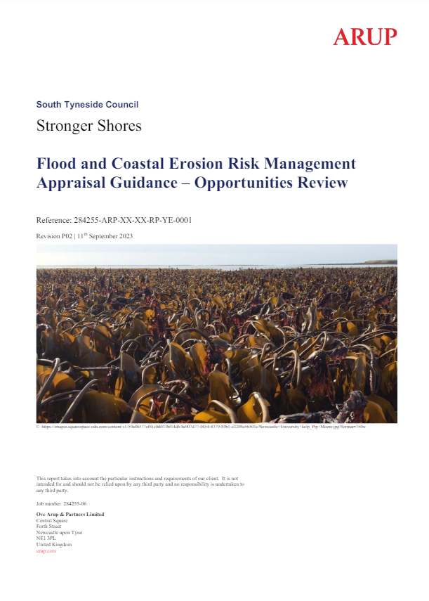
Progress Update
To inform the toolkit specification, we completed an initial gap analysis of existing FCERM resources.
The findings are reported in the Opportunities Review and recommendations captured in a Toolkit Action Plan.
This might currently be considered a ‘long-list’ of content options, which needs refining.
Before we finalise design of the toolkit, we want input from a broader audience of those with first hand experience delivering marine projects.
Notes:
Will also note here the great progress being made by delivery partners and shift in momentum.
We will be designing the toolkit to be adaptable and the production of outputs to be agile.
This reflects the innovative nature of the programme and the level of uncertainty.
There is a chicken and egg element to what the final toolkit looks like, dependent on the findings of the various different projects within the Stronger Shores programme.

Slide 5
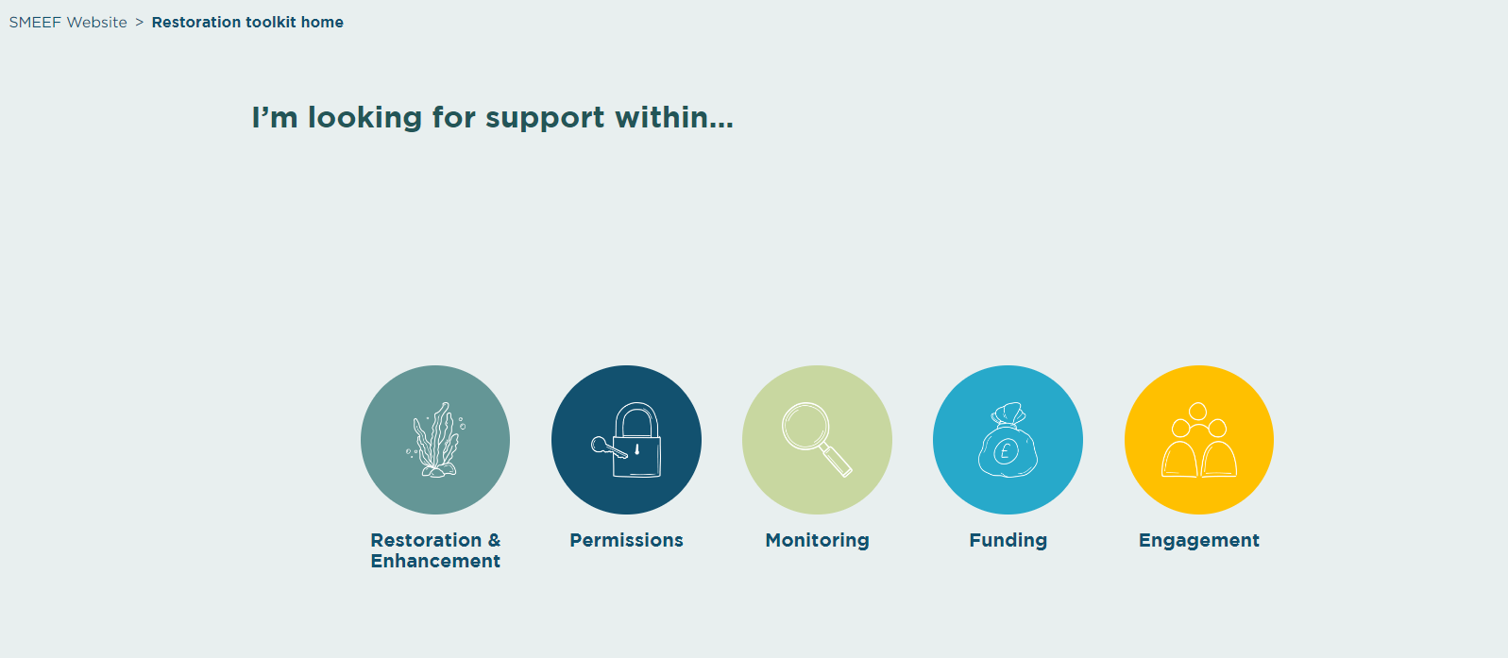
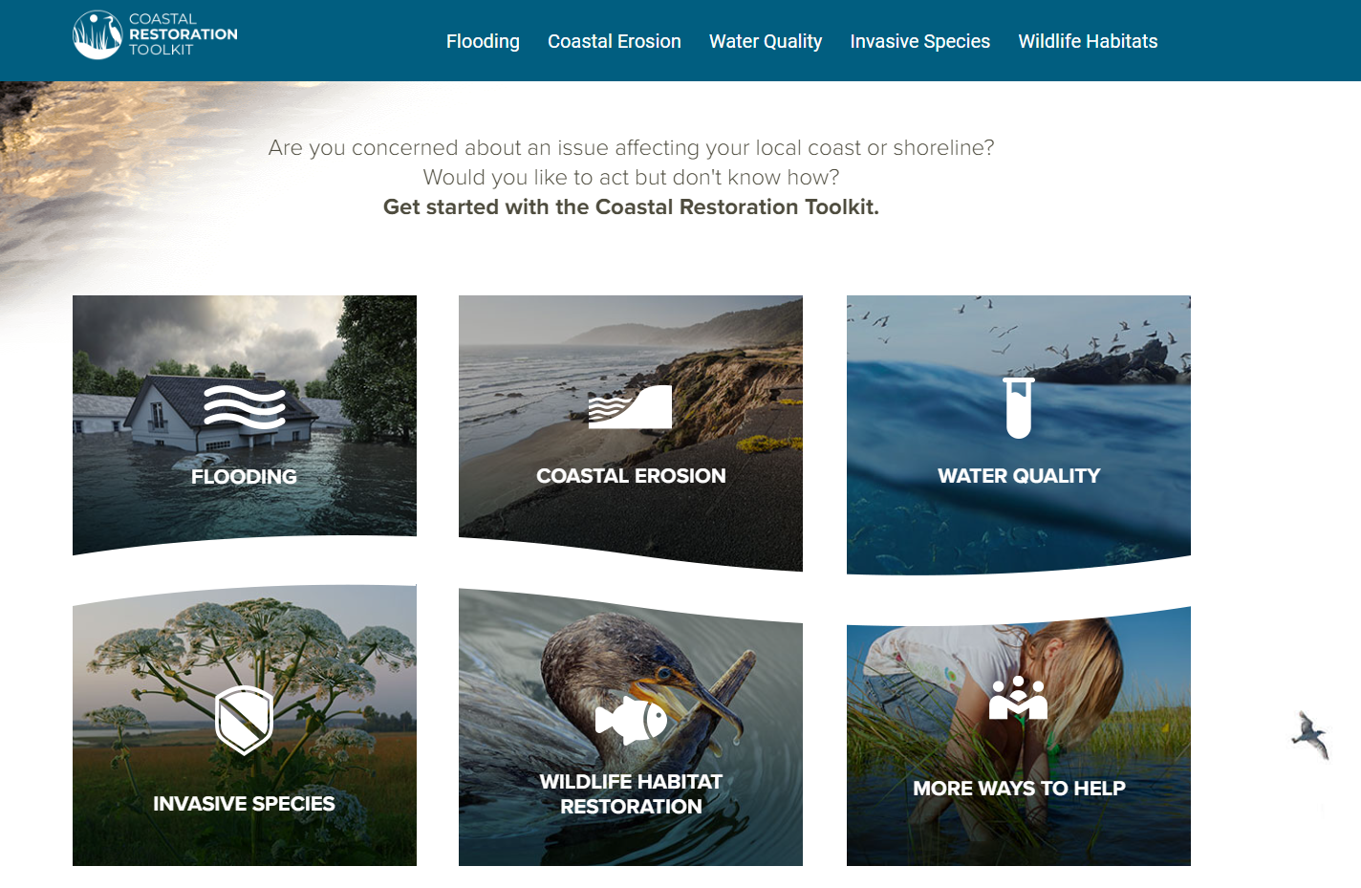
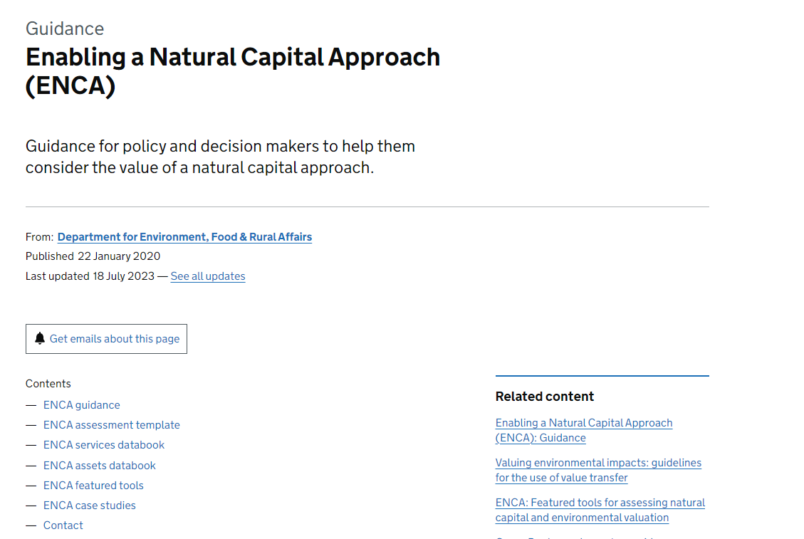
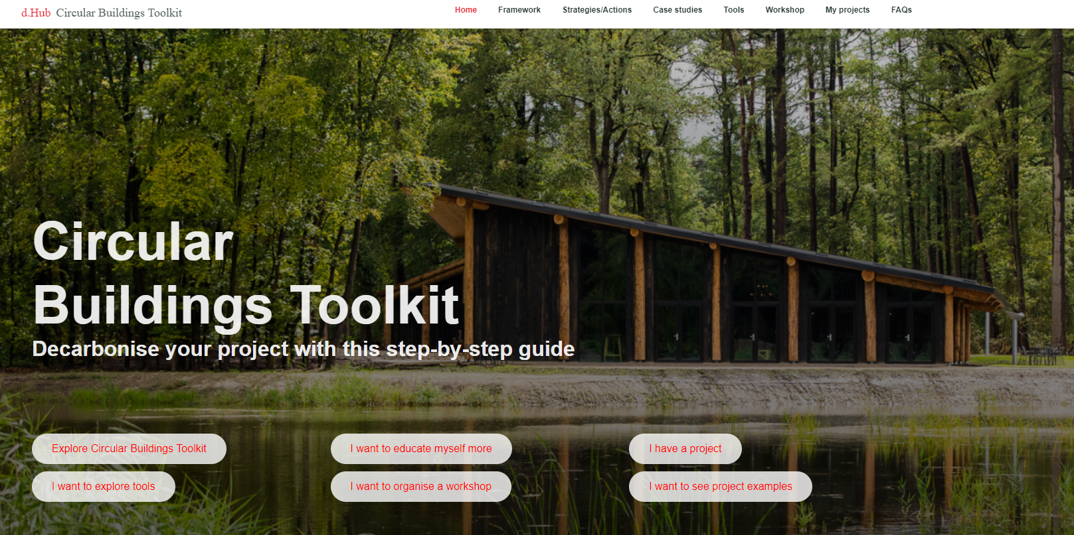
Learning from Precedent Examples
Want to avoid reinventing the wheel – What best practice examples are out there already?
SMEEF Restoration Toolkit
Coastal Restoration Toolkit
SMEEF Restoration Toolkit for marine enhancement with resources grouped by categories of support, such as ‘Funding’ etc
Toolkit from Restore America’s Estuaries with guidance grouped according to issue, such as ‘Flooding’, ‘Erosion’, or ‘Invasive Species’
© SMEEF 2024
© Restore America’s Estuaries 2024
Enabling a Natural Capital Approach (ENCA)
Circular Buildings Toolkit
Arup Toolkit for Circular Buildings with information grouped under headings, such as ‘Tools’, ‘Case Studies’, ‘Framework’, etc
DEFRA Toolkit containing a series of documents, links, and tools for the ENCA process, structured in a guidance webpage
© DEFRA 2020
©ARUP and the Ellen Macarthur Foundation 2024
Notes:
SMEEF – Restoration Toolkit
Scottish Marine Environmental Enhancement Fund – Restoration Toolkit – Information on Restoration and Enhancement, Permissions, Monitoring, Funding and Engagement in a series of FAQ type questions and checklists for your project
https://smeef.scot/restorationtoolkit/?p=start
Restore America’s Estuaries – Coastal Restoration Toolkit
Toolkit structured by issue, ‘Flooding’, ‘Coastal Erosion’, ‘Water Quality’, ‘Invasive Species’, ‘Wildlife Habitats’ – under each issue there are a further series of resources – project development, tools & resources, contacts, funding, permitting, and project examples
https://restoreyourcoast.org/
Defra – Enabling a Natural Capital Approach
A series of weblinks structured to provide guidance for policy and decision makers to help consider a natural capital approach, links to documents, excel toolkits, data sources, tools and case studies.
https://www.gov.uk/guidance/enabling-a-natural-capital-approach-enca
Arup – Circular Buildings Toolkit
Arup and Ellen Macarthur Foundation developed toolkit for circular buildings. Information is grouped under ‘Framework’, ‘Strategies/Actions’, ‘Case Studies’, ‘Tools’, ‘Workshop’, ‘Projects’, ‘FAQs’
https://ce-toolkit.dhub.arup.com/
Additional Examples:
Bluedot Associates – Marine toolbox - https://bluedotassociates.com/restoration-tools-and-guidance/
The Flood Hub – Natural Flood Management (NFM) toolkit - https://thefloodhub.co.uk/natural-flood-management-nfm-toolkit/
JNCC – Nature-based Solutions Triple Win Toolkit - https://jncc.gov.uk/our-work/nbs-triple-win-toolkit/

Slide 6
Principles of the Toolkit
Practical - meet the key needs of users
Adaptable - ensure long-term value
Affordable - low maintenance/running costs
Intuitive - easy to navigate and use
Integrated - complementary to wider resources

Slide 7
Stakeholder Inputs
Going back to the Q on the 1st slide, please start thinking about what a Stronger Shores toolkit means to you.
We will be work-shopping the design later in the day and welcome any and all inputs.
MUST HAVES?
OR
NICE TO HAVES?
Improved Habitat Asset Mapping
Natural Capital accounts
Funding Guidance
Consenting Strategy
Modelling Guidance
Strategic Partnership Advice

