Slide 1
Engagement
Stronger Shores, Stronger Together

Slide 2
WHAT DOES ENGAGEMENT MEAN TO US?
Meaningful
Innovative
Developing understanding
Notes:
Engage in a meaningful way with key audiences to build relationships and have a deeper, more sustained, impact.
Develop and test innovative ways to engage audiences in nature-based solutions for coastal resilience.
Drive engagement with coastal engineers and decision makers to encourage them to consider nature-based solutions.

Slide 3
WHO ARE WE ENGAGING WITH?
Community
Business and Investors
Decision Makers
Academics and Researchers
Notes:
All 4 audiences have a different reason to engage.
Decision Makers
Engage with Stronger Shores to make the right evidence-based decisions for people, place and planet.
Community
Make a difference to where you live and the planet by coming together with like-minded people to learn about and protect marine wildlife.
Business and Investors
Invest in innovative, leading research to get the evidence needed to reach new markets for nature-based solutions to the climate crisis.
Academics and Researchers
Collaborate with experts and leading academics to be part of a pioneering research community finding evidence-based solutions to the climate crisis.
This presentation is going to focus on the community engagement side of the project as this is what Emily and Blair lead on.
4 key areas:
Amble, Northumberland
South Shields, South Tyneside
Seaham, Durham
Redcar, Redcar and Cleveland
BUT we cover 7 local authority areas so we are trying to work with as many people as we can!

Slide 4
WHO ARE WE ENGAGING WITH?
Community
Business and Investors
Decision Makers
Academics and Researchers
Notes:
All 4 audiences have a different reason to engage.
Decision Makers
Engage with Stronger Shores to make the right evidence-based decisions for people, place and planet.
Community
Make a difference to where you live and the planet by coming together with like-minded people to learn about and protect marine wildlife.
Business and Investors
Invest in innovative, leading research to get the evidence needed to reach new markets for nature-based solutions to the climate crisis.
Academics and Researchers
Collaborate with experts and leading academics to be part of a pioneering research community finding evidence-based solutions to the climate crisis.
This presentation is going to focus on the community engagement side of the project as this is what Emily and Blair lead on.
4 key areas:
Amble, Northumberland
South Shields, South Tyneside
Seaham, Durham
Redcar, Redcar and Cleveland
BUT we cover 7 local authority areas so we are trying to work with as many people as we can!

Slide 5
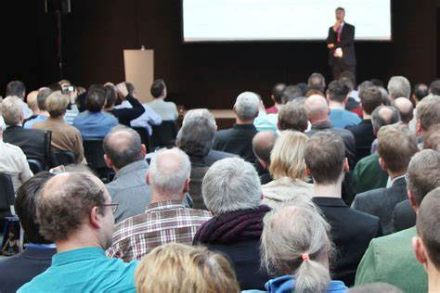
HISTORICAL ENGAGEMENT
Talked ‘at’ people through:
Consultations
Lectures
Talks
“Outreach”
Notes:
All 4 audiences have a different reason to engage.
Decision Makers
Engage with Stronger Shores to make the right evidence-based decisions for people, place and planet.
Community
Make a difference to where you live and the planet by coming together with like-minded people to learn about and protect marine wildlife.
Business and Investors
Invest in innovative, leading research to get the evidence needed to reach new markets for nature-based solutions to the climate crisis.
Academics and Researchers
Collaborate with experts and leading academics to be part of a pioneering research community finding evidence-based solutions to the climate crisis.
This presentation is going to focus on the community engagement side of the project as this is what Emily and Blair lead on.
4 key areas:
Amble, Northumberland
South Shields, South Tyneside
Seaham, Durham
Redcar, Redcar and Cleveland
BUT we cover 7 local authority areas so we are trying to work with as many people as we can!

Slide 6
Our Story
April 2023-March 2026

Slide 7
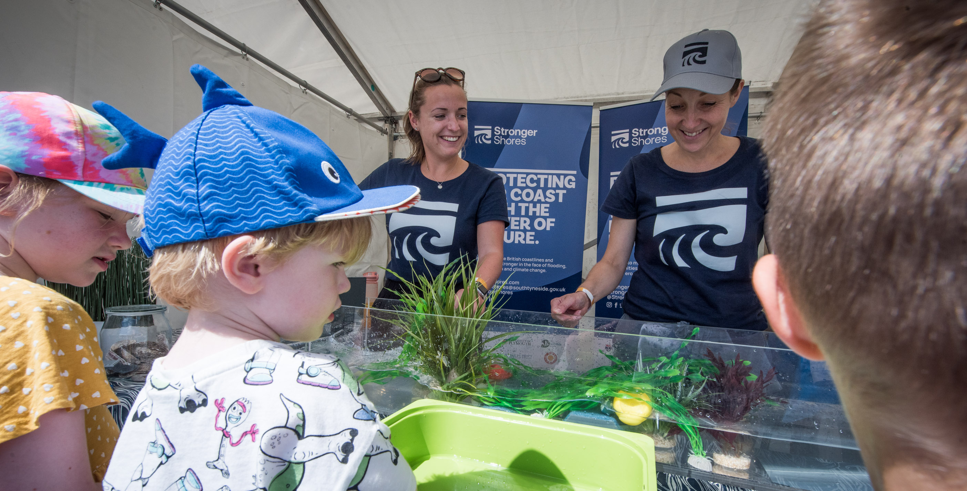
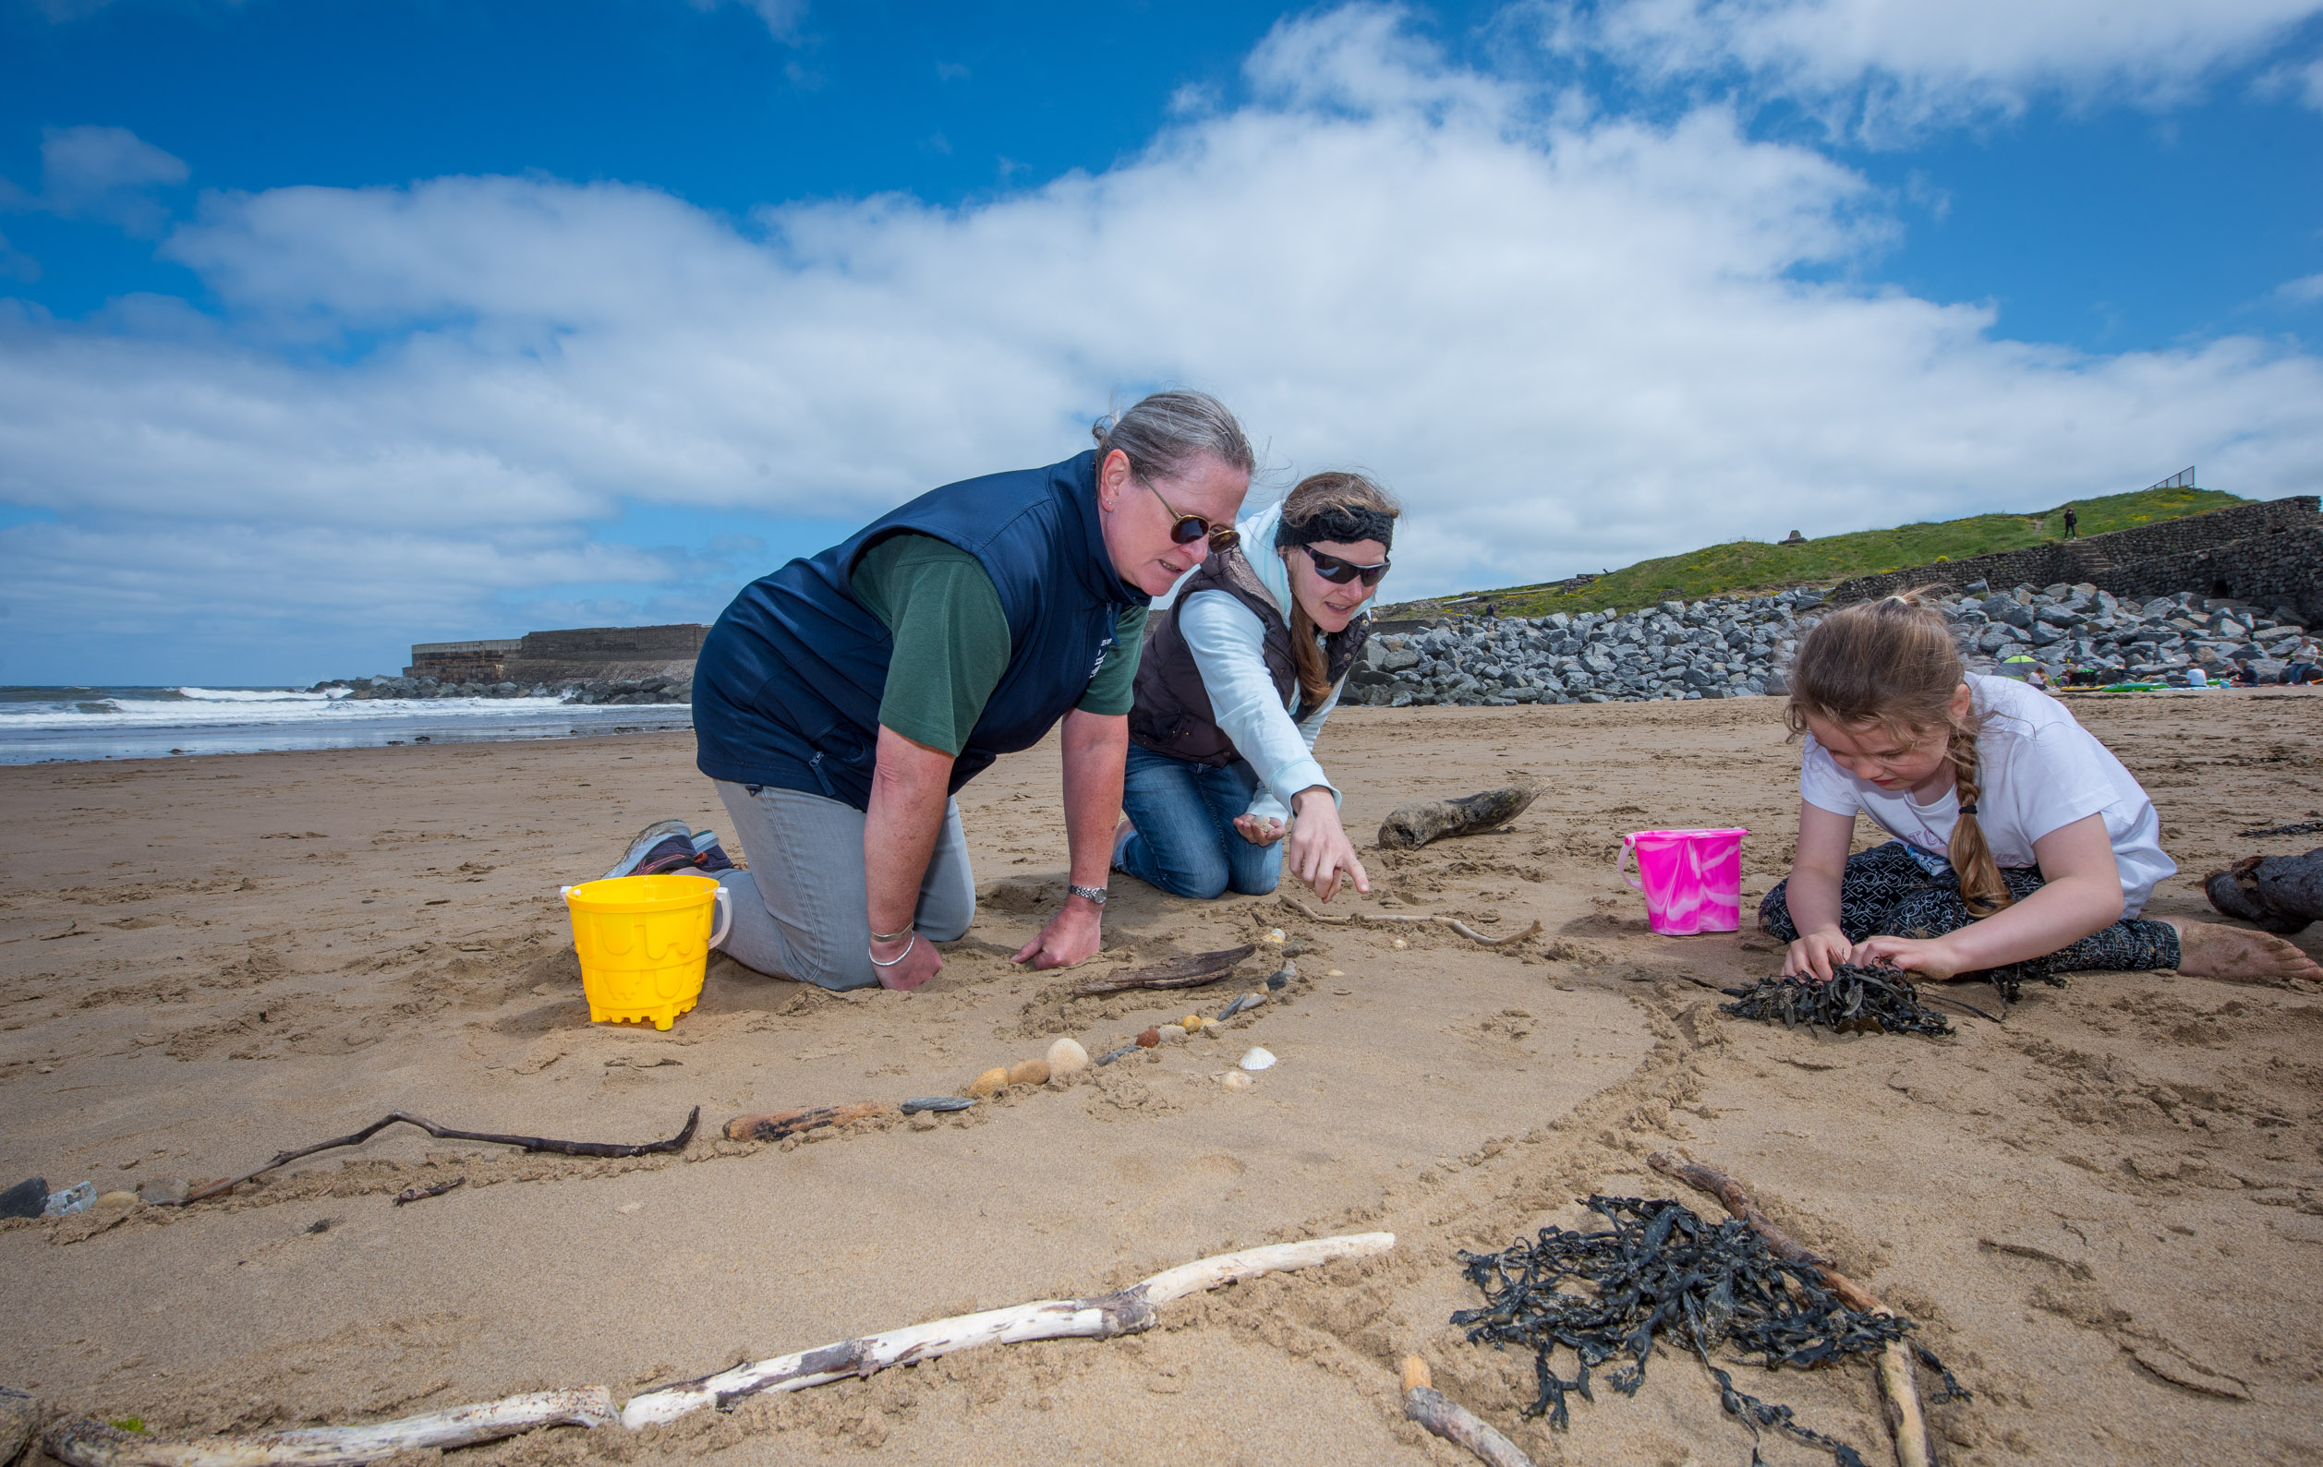
WIDER COMMUNITY
Engaged with over 3,500 people at high footfall community events.
Amble Puffin Festival
St Mary’s Lighthouse Festival
South Shields Surf Festival
This is South Tyneside Festival
Ocean Road Mela
Hartlepool Tall Ship Races
Many events planned for summer 2024!
Notes:
Past and coming up
Pint of Science

Slide 8
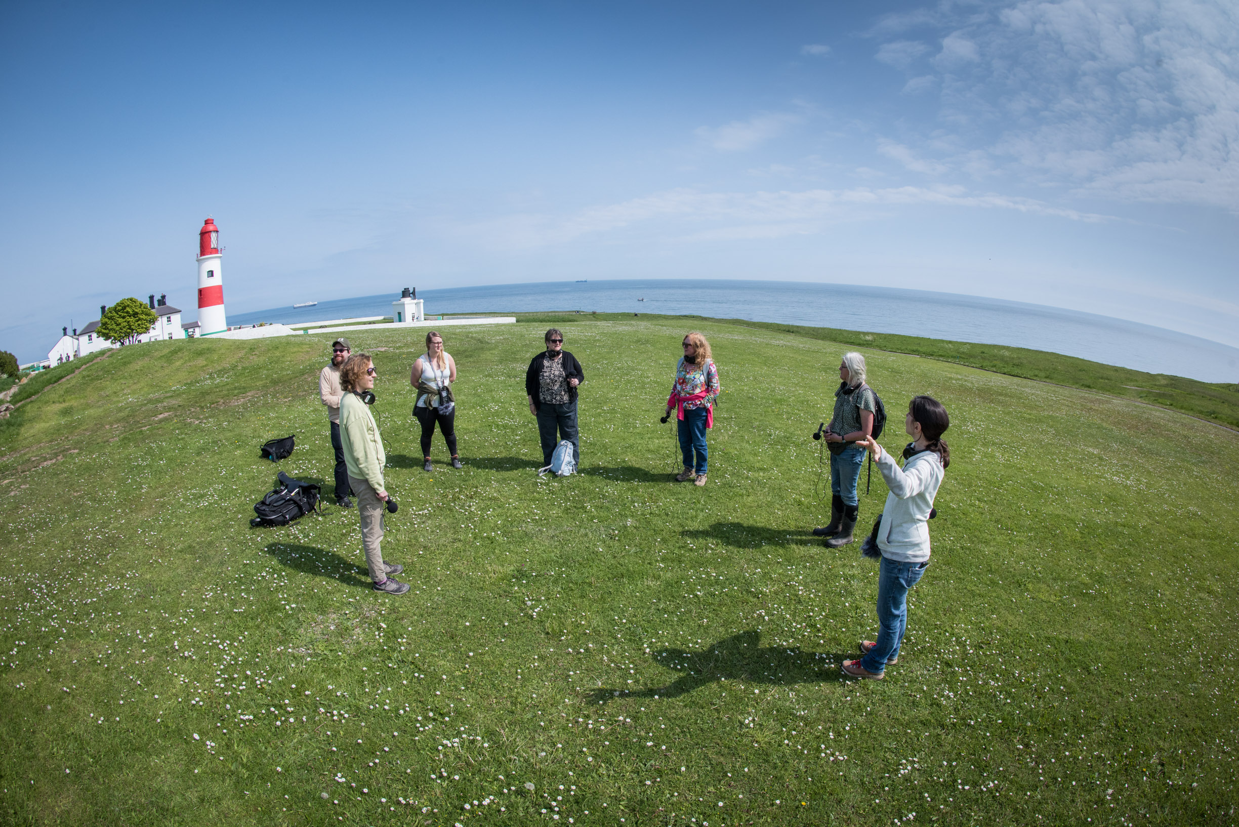
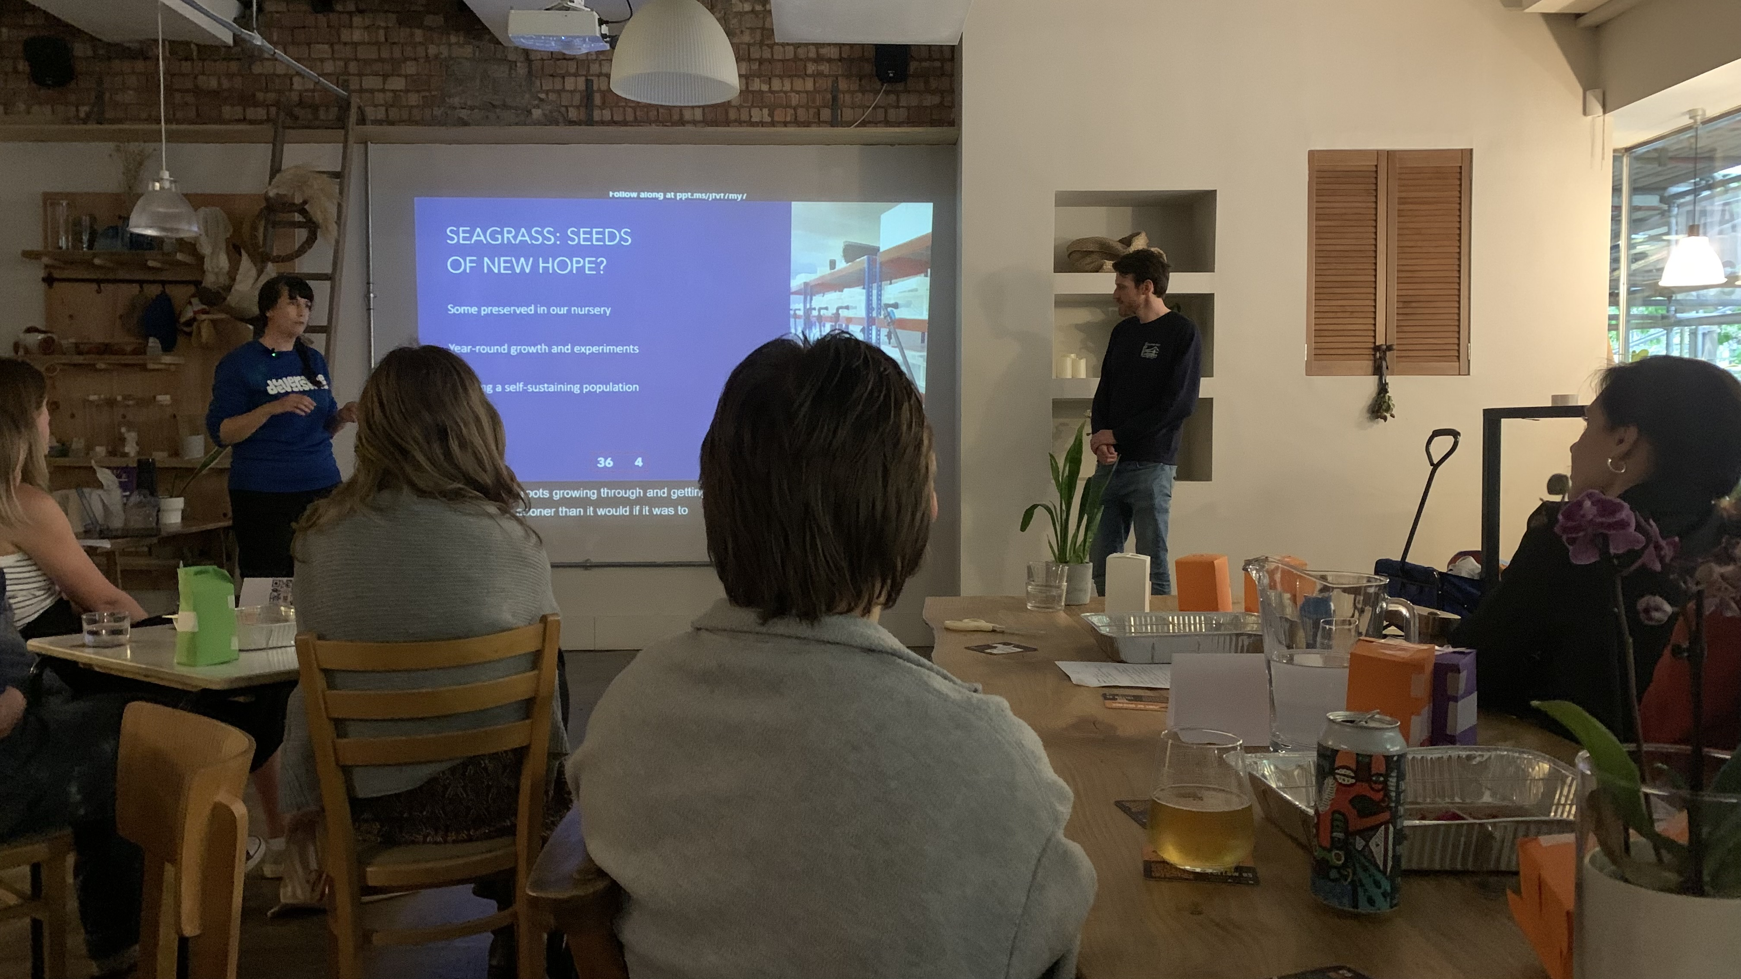
COMMUNITY AUDIENCES
Underserved Audiences connecting through art & experiencing nature
Youth Groups
ESOL/ Refugee Groups
Community Learning and Development Groups
Place-based Communities
Those near ‘sites of interest’ including Amble, Whitburn, Seaham, Skinningrove…
Notes:
What we done so far and what we are doing.
Example Be the Sea

Slide 9
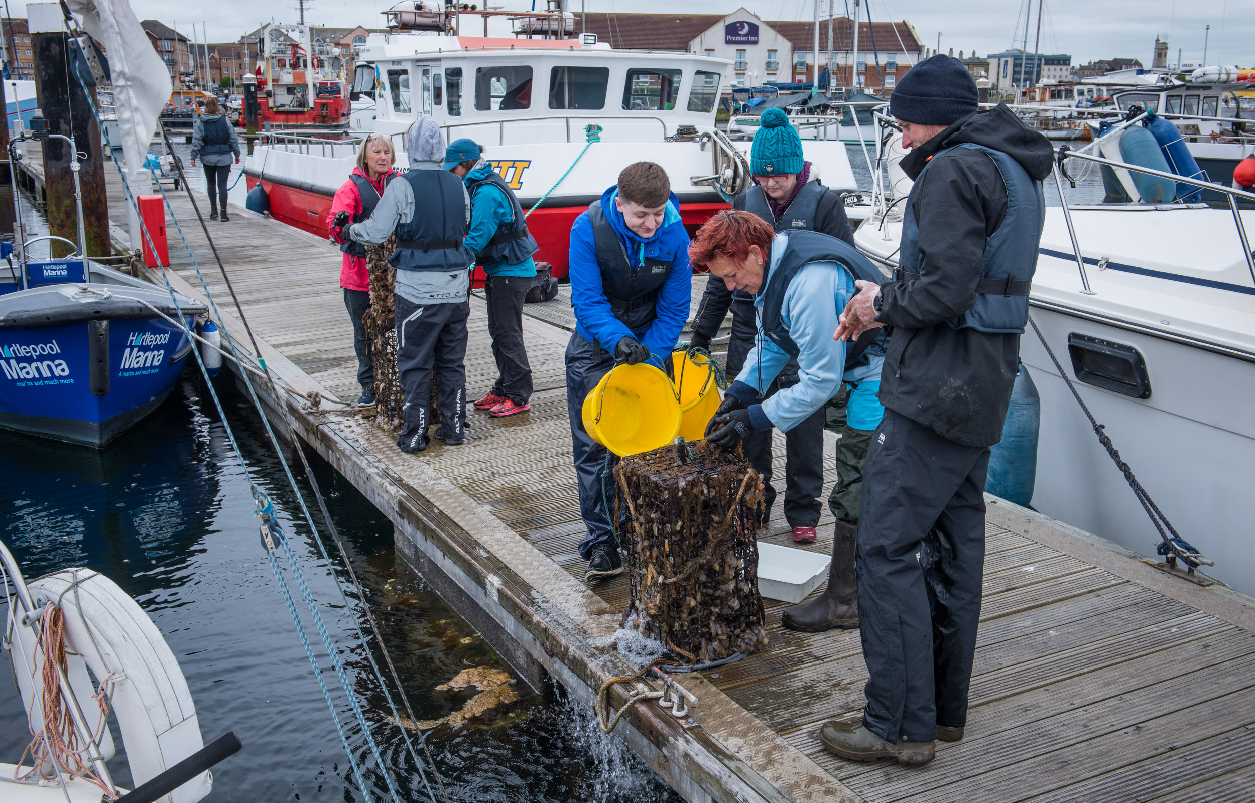
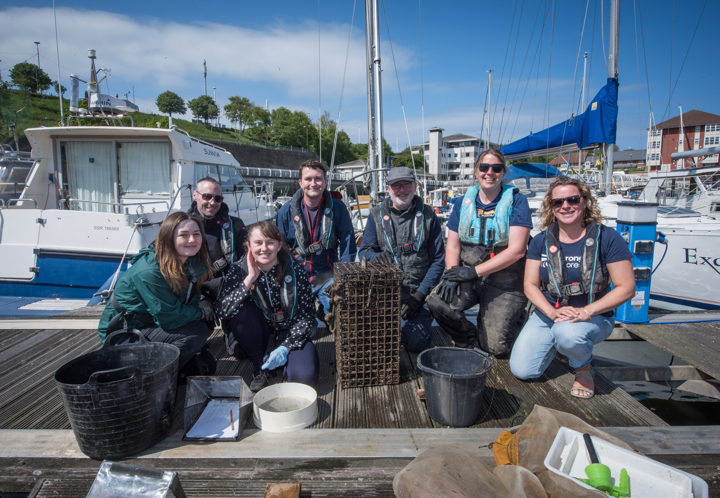
GETTING INVOLVED
Oyster Monitoring
Oyster Scrubbing
Seagrass planting
Citizen Science

Slide 10
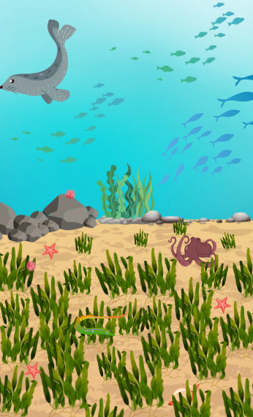
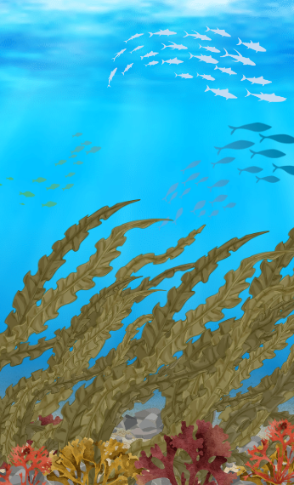
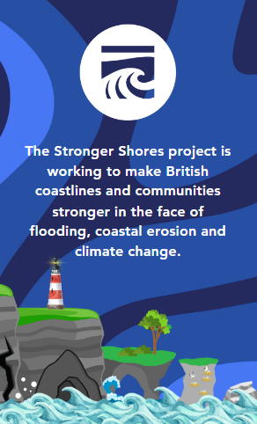
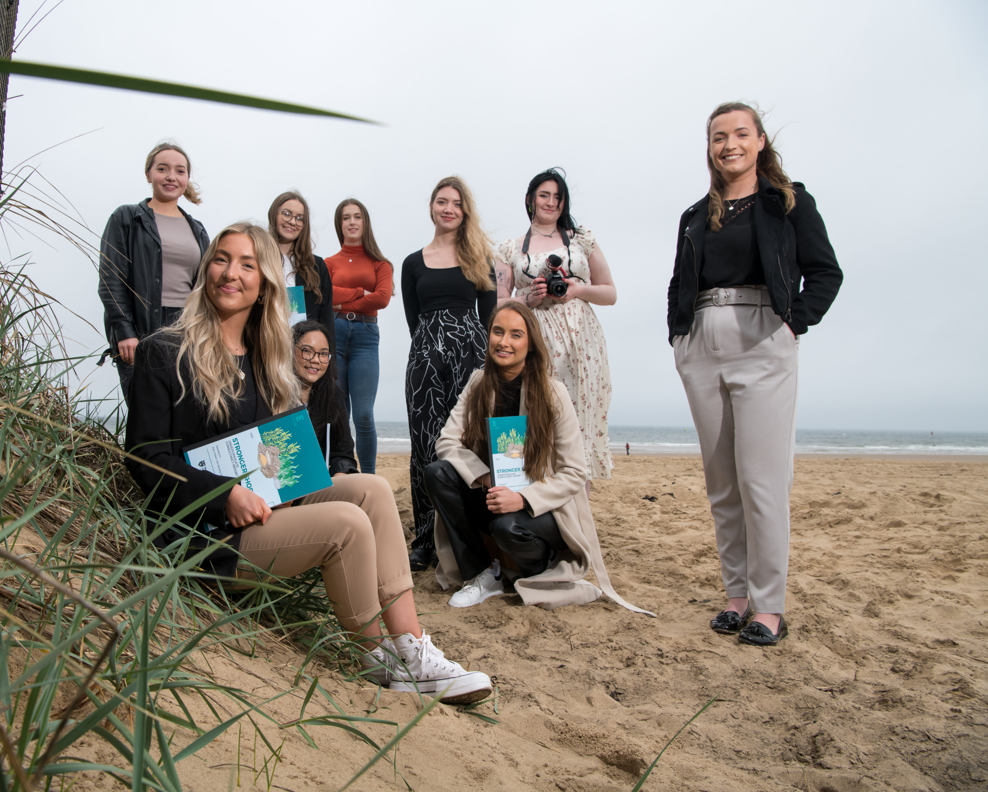
FORMAL EDUCATION
Education Packs Online
- Climate Change
- Coastal Erosion
- Stronger Shores Work
- Careers
In Person Workshops
- KS2
- KS3
Global STEM Awards
Northumbria University Business Clinic
Northumbria University Business Clinic
Notes:
Past
Education packs. Tray.

Slide 11
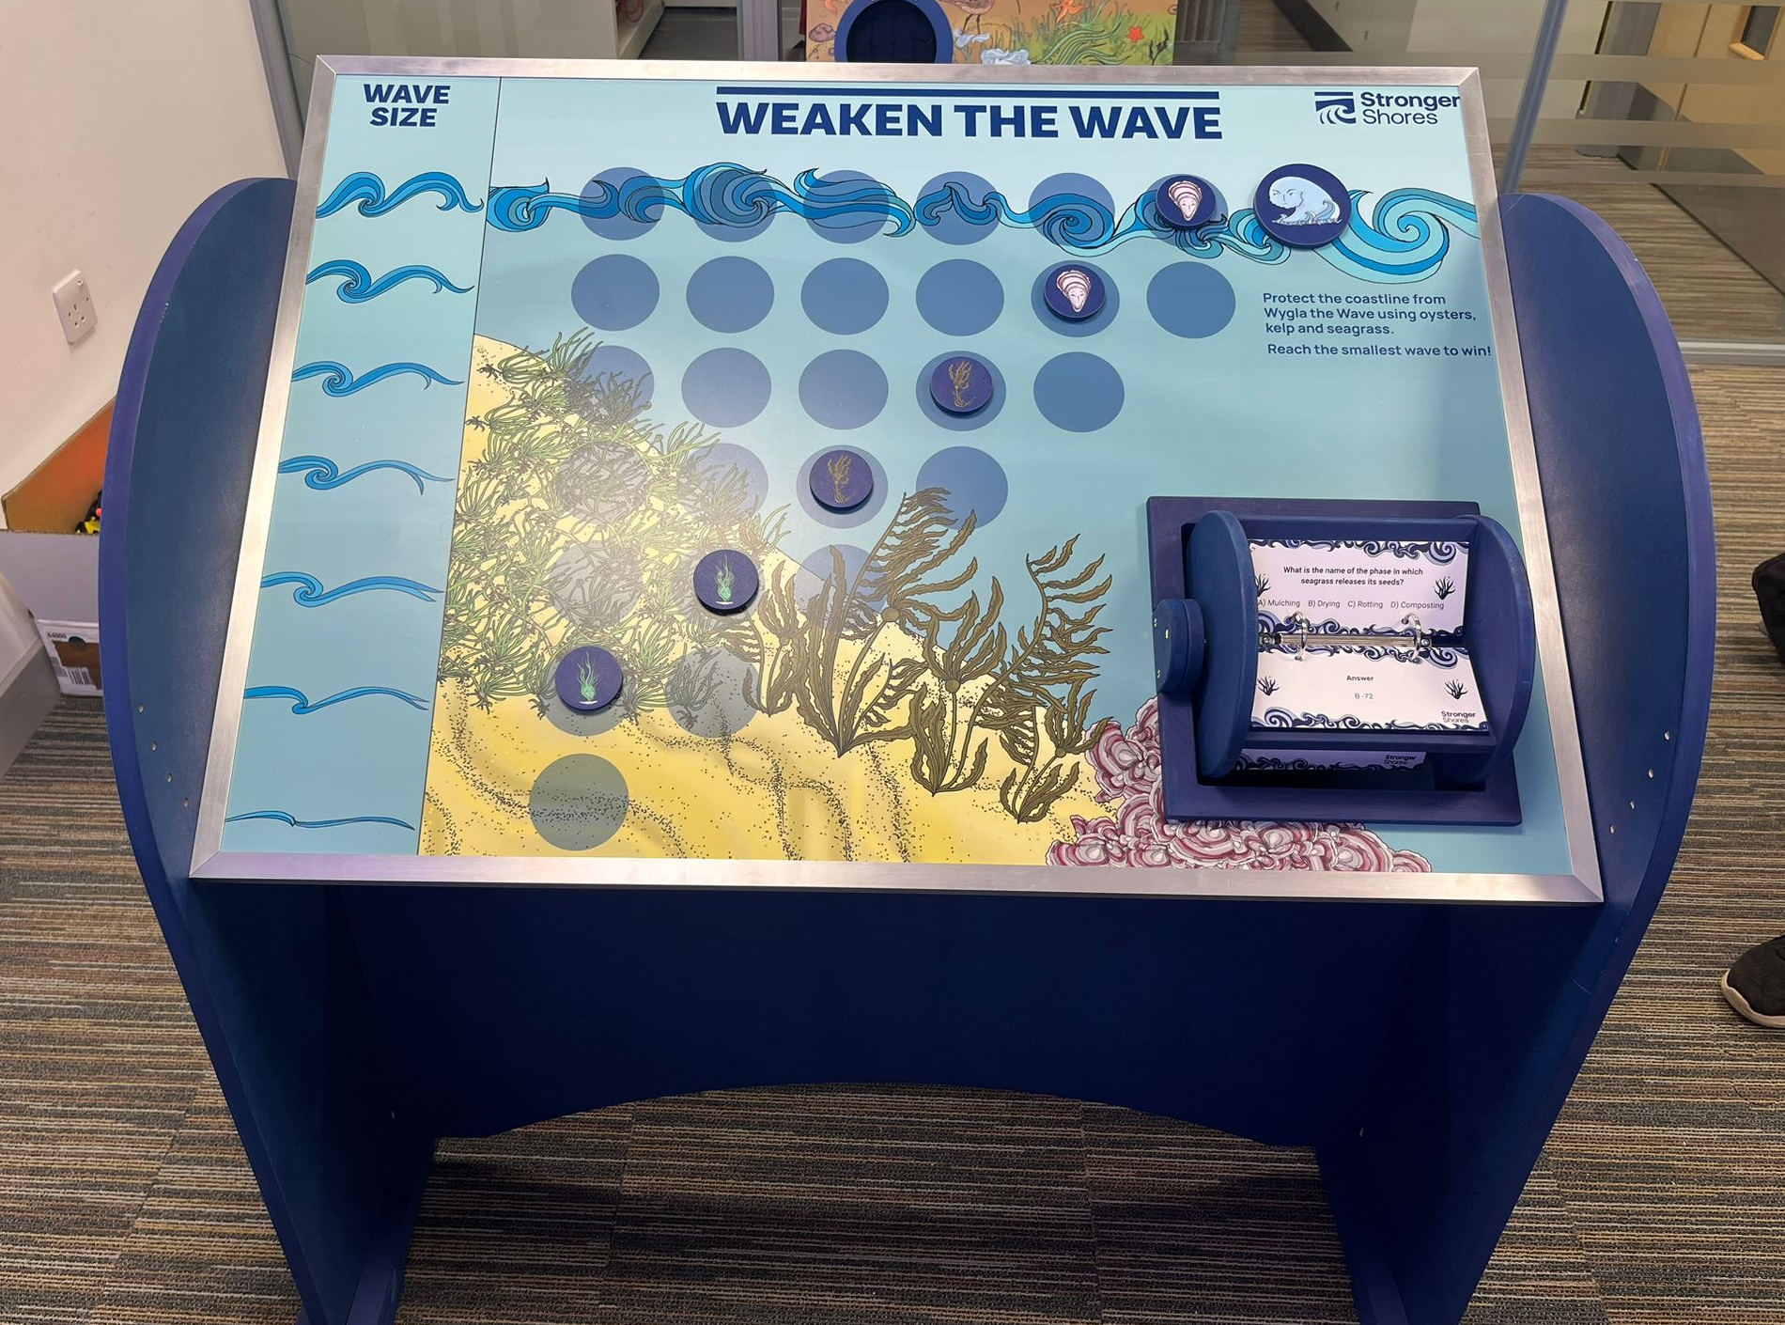
RESOURCES
Weaken the Wave
Seagrass Saver Challenge
Biodiversity Jenga
Food Web Tag
Wave Tank Inserts
Notes:
Me.

Slide 12
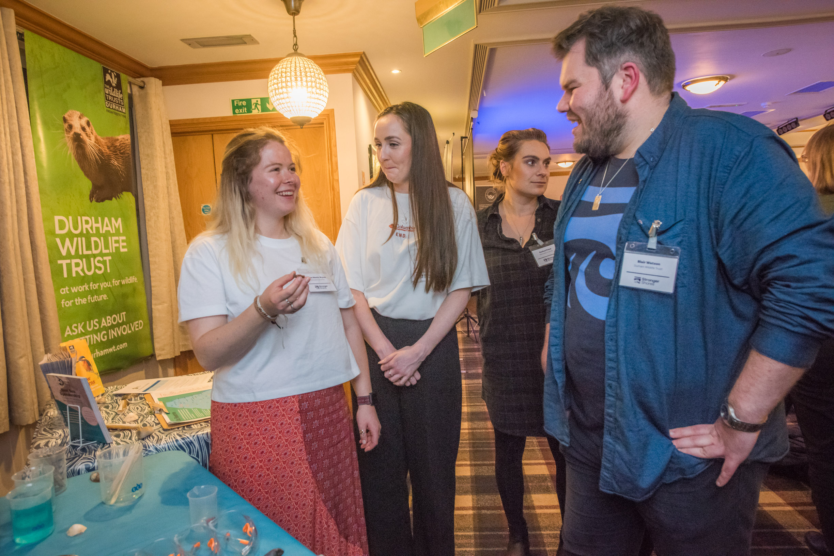
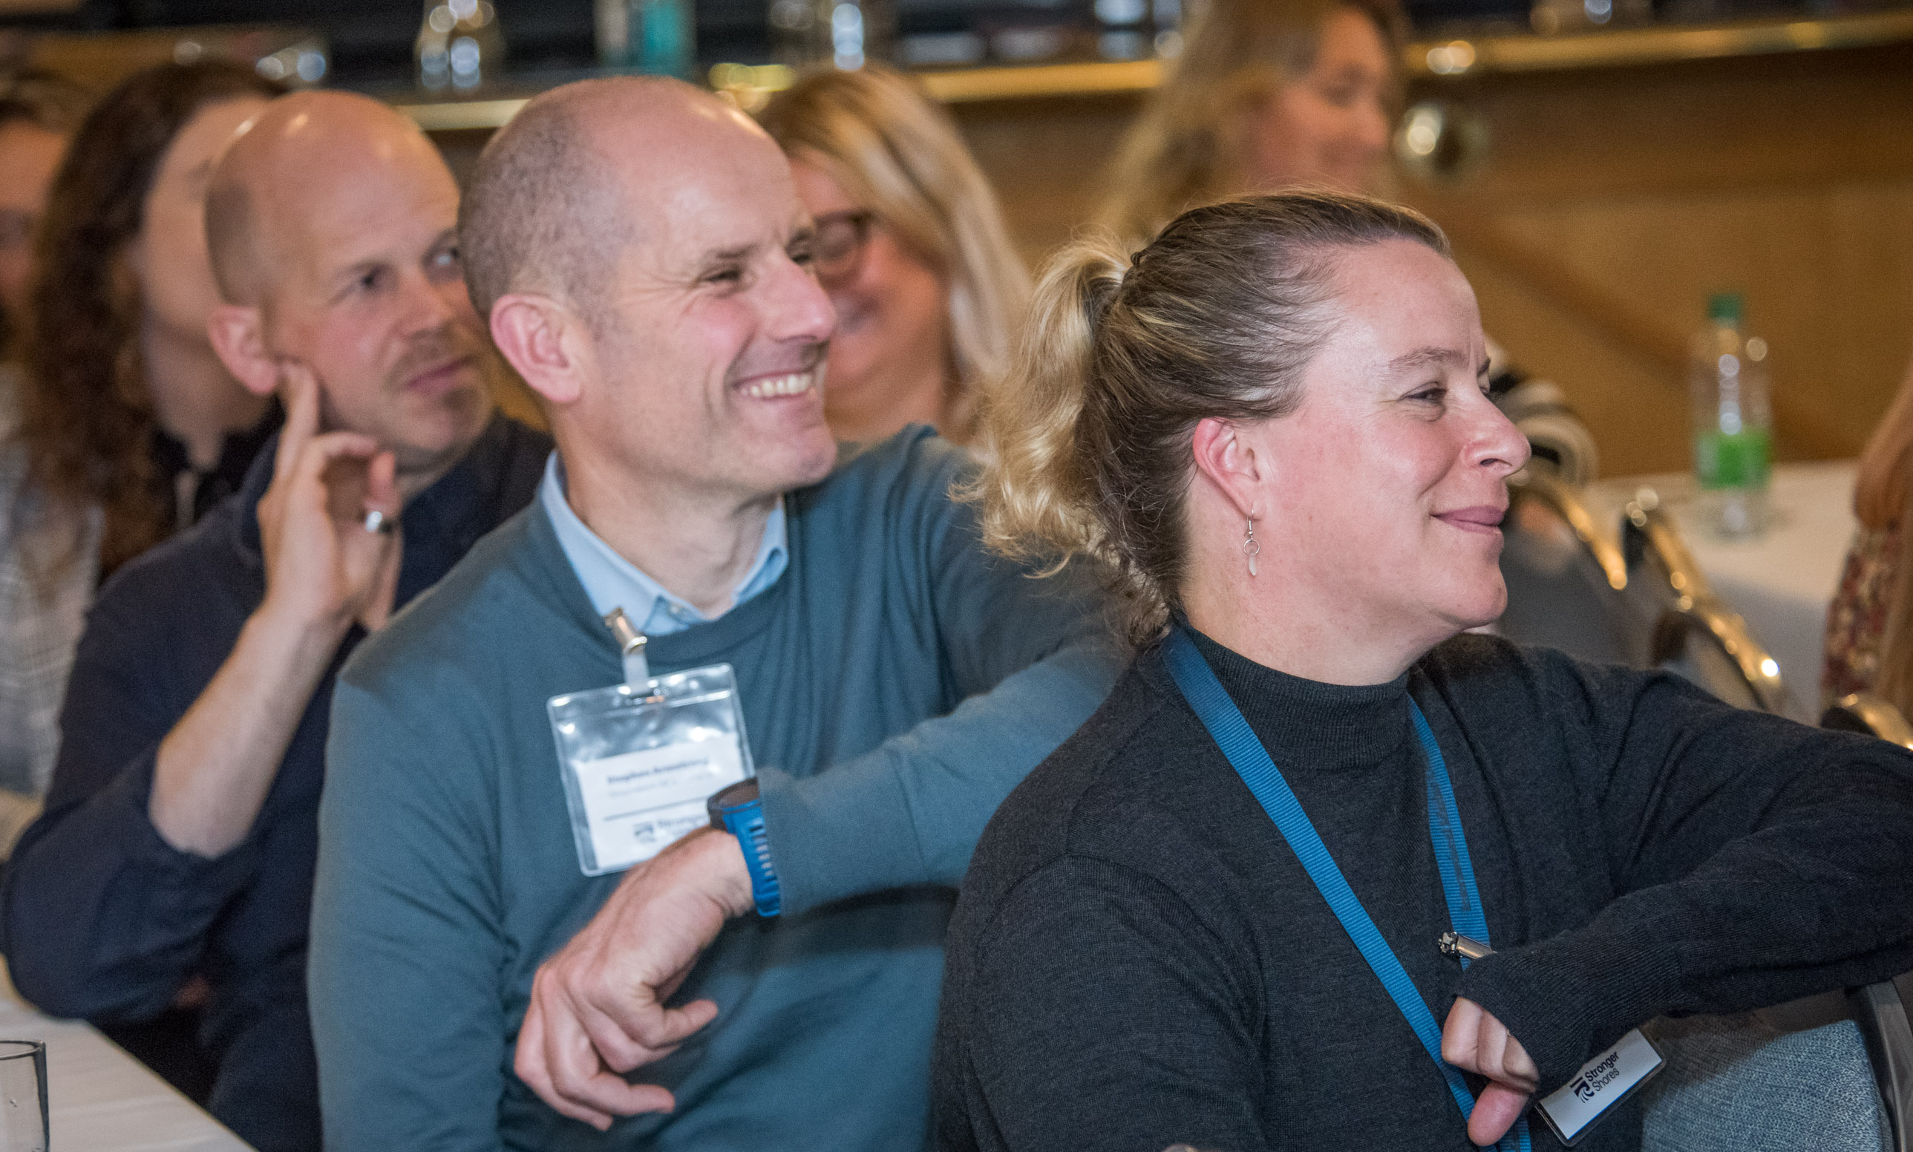
INNOVATING & ENGAGING
COMMUNITY VOICE METHOD
Inclusive, informed and persistent dialogue
Creates a research based insight into local discourse tailored to project.
PARTICIPATION MAPPING
Identify future opportunities and barriers
Tailored to particular area
Builds knowledge stored amongst local peoples

Slide 13
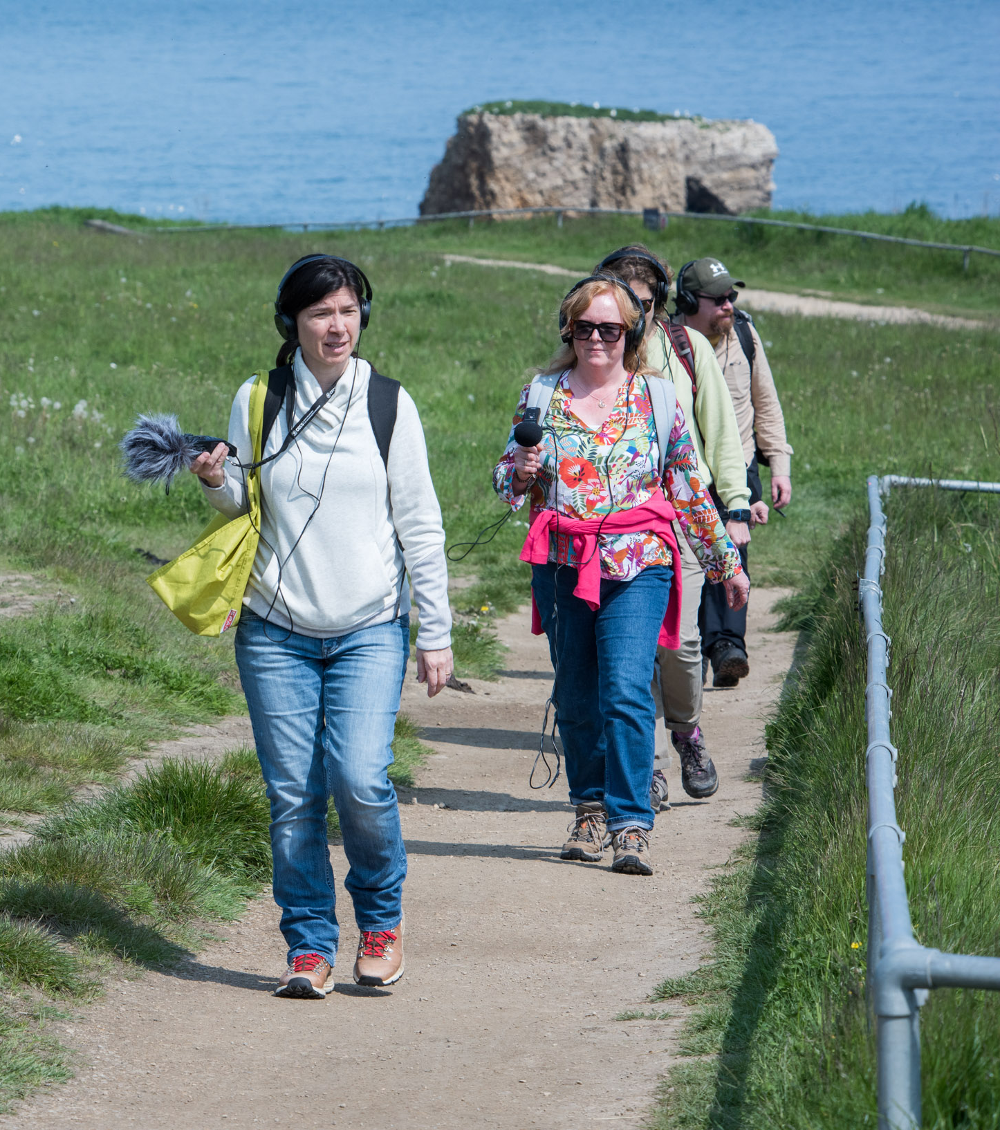
ENGAGING THROUGH ART
Reaches out to audiences that may react negatively to STEM.
Creates new ways of understanding
Inspires creativity
Challenges ways of thinking
Increases accessibility
Notes:
Be the Sea
Blue Waves
Beach of Dreams

Slide 14
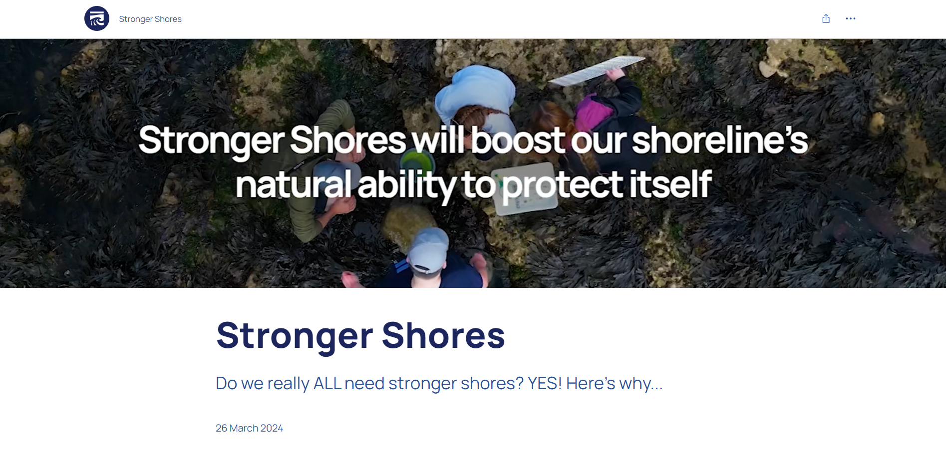
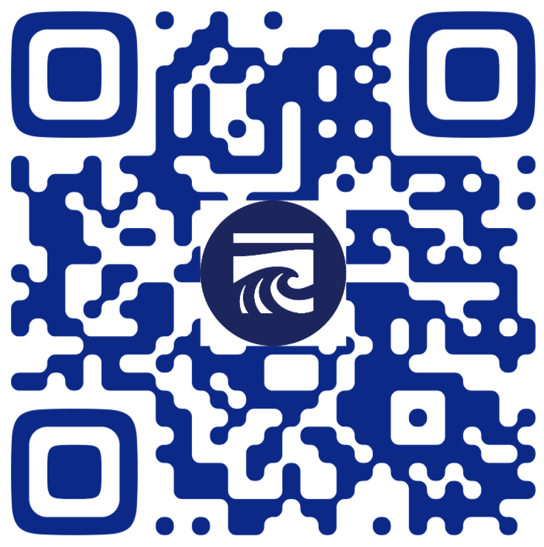
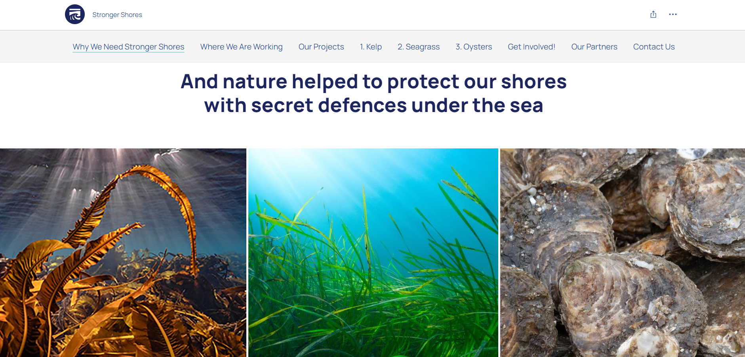
STORY MAP
Tells the story of Stronger Shores
Engaging
Visual
Legacy of the project, highlighting the key milestones experienced through the project.

Slide 15
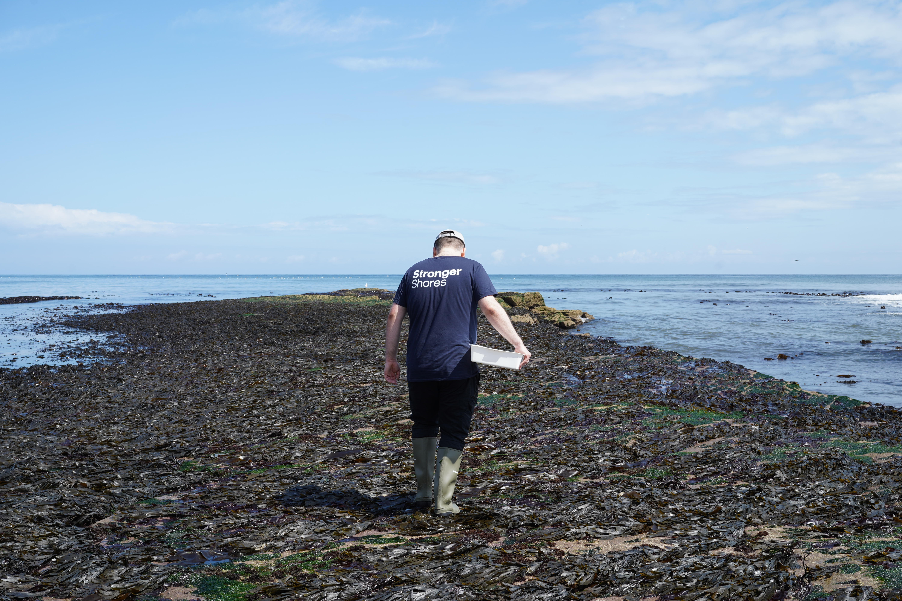
LESSONS LEARNT
One size does not fit all
Must consider other priorities
Procurement issues
Having good resources
Simple language
Having a clear offer
Manage expectations.
People may not be wearing the right gear
Meet people where they are comfortable
Notes:
All 4 audiences have a different reason to engage.
Decision Makers
Engage with Stronger Shores to make the right evidence-based decisions for people, place and planet.
Community
Make a difference to where you live and the planet by coming together with like-minded people to learn about and protect marine wildlife.
Business and Investors
Invest in innovative, leading research to get the evidence needed to reach new markets for nature-based solutions to the climate crisis.
Academics and Researchers
Collaborate with experts and leading academics to be part of a pioneering research community finding evidence-based solutions to the climate crisis.
This presentation is going to focus on the community engagement side of the project as this is what Emily and Blair lead on.
4 key areas:
Amble, Northumberland
South Shields, South Tyneside
Seaham, Durham
Redcar, Redcar and Cleveland
BUT we cover 7 local authority areas so we are trying to work with as many people as we can!

Slide 16
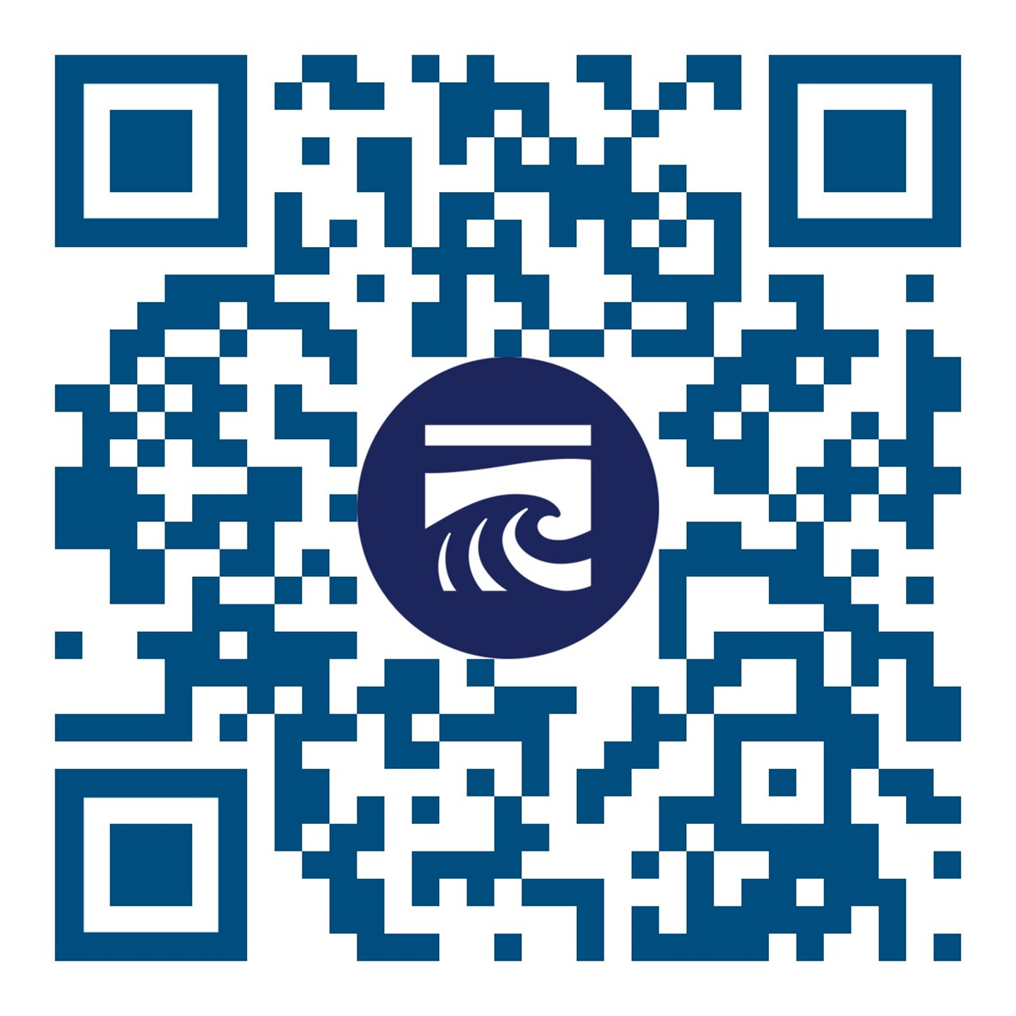
Thank you for listening
StrongerShores@southtyneside.gov.uk

