Slide 2
Restoring the Tees Estuary – or try, try, try again….

Slide 3
The Tees
Length: 198km
Area: 1789km2
Population: 700k

Slide 4
The Tees Estuary

Slide 5
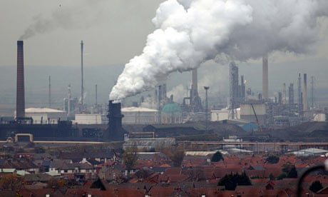
And its challenges…..

Slide 6
Where to start?
2018 Immerse EU Partnership Project
Seagrass and aquaculture feasibility
Sites identified, methodologies refined……
COVID…………
2021 Green Recovery Challenge Fund
Seedcorn funding to install seagrass nursery
Initial seagrass work begins…
First native oyster hoists installed ….
2023 Stronger Shores……

Slide 7
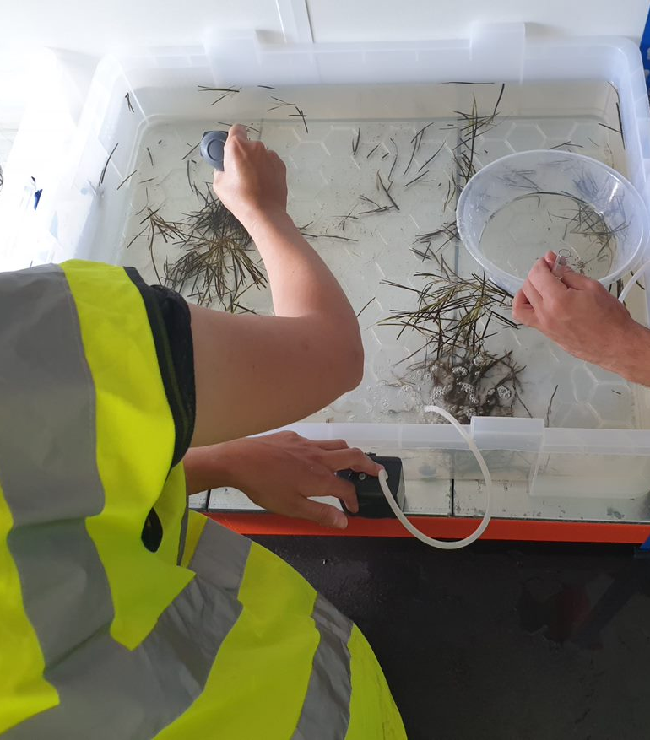
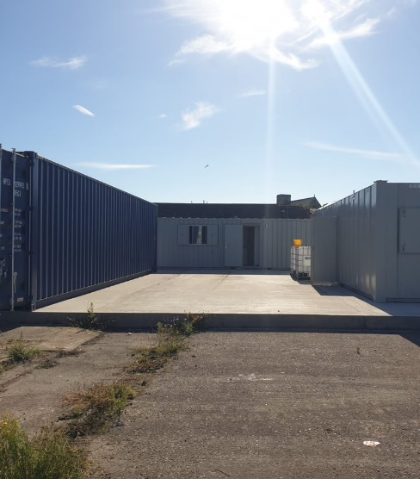
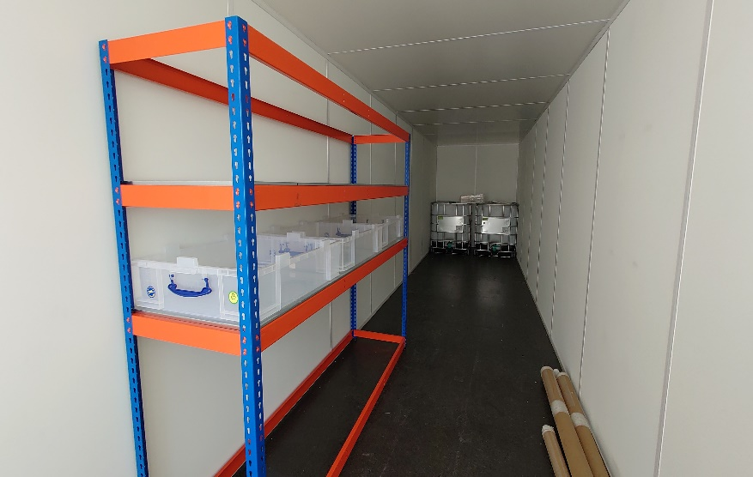
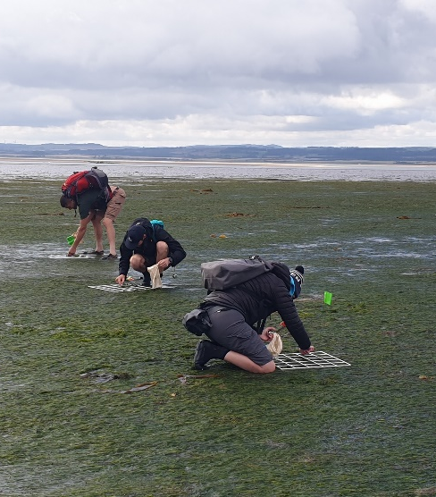
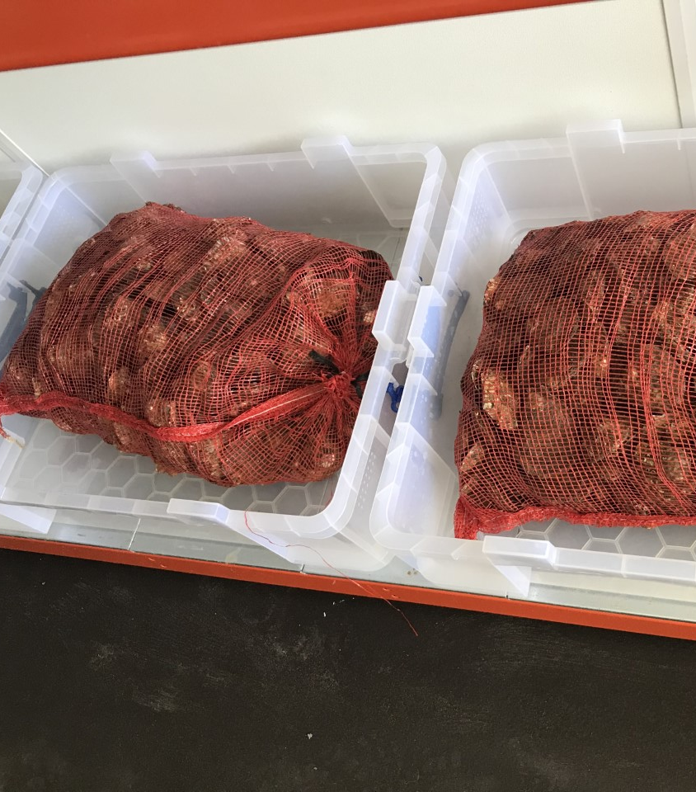
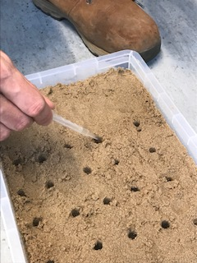
Where we started post Covid (2nd time around)
July 2022 - First units on site
August 2022 - 1st seagrass collection
September 2022 – First seagrass planted in the estuary
September 2022 - Our adult oysters had arrived

Slide 8
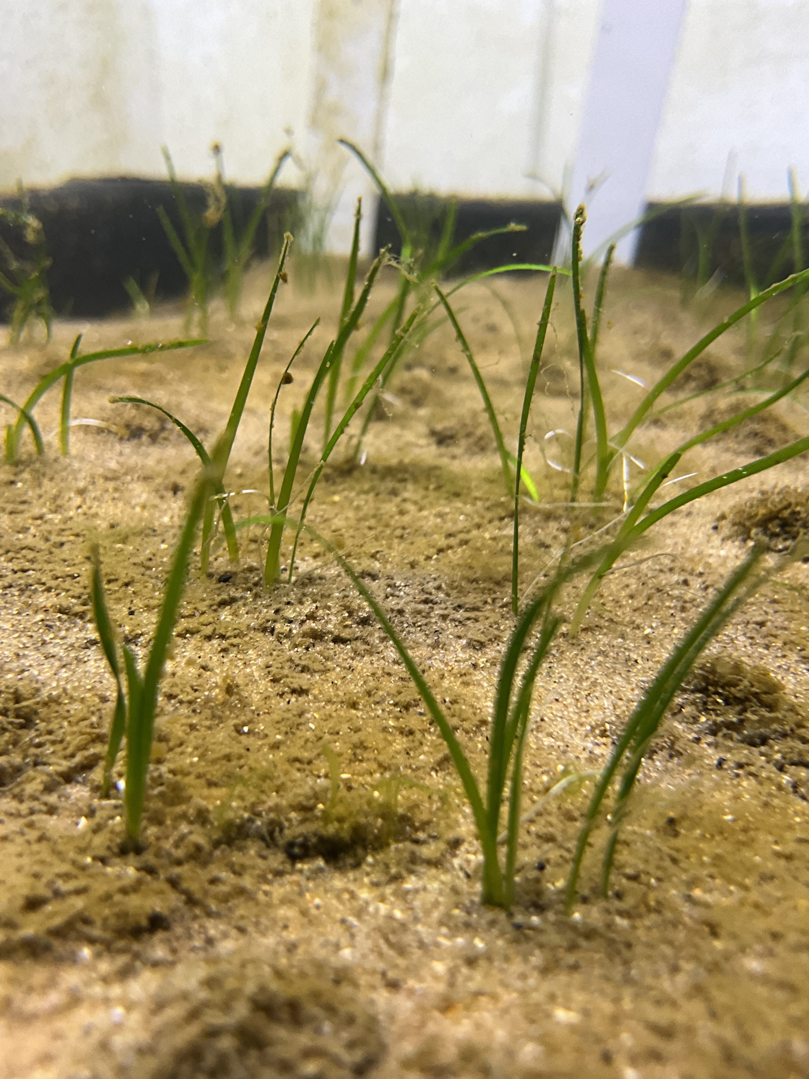
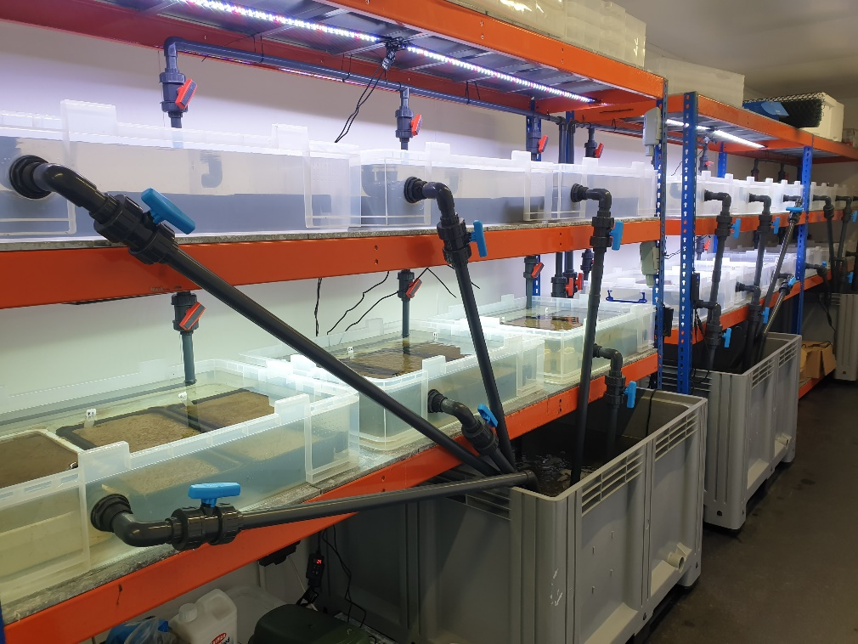
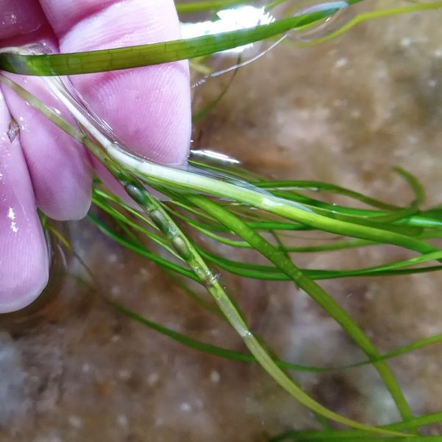
And now….
The North East’s first and only terrestrial seagrass nursery
Fully functioning facility – fully embedded within the seagrass nursery network around the UK
2nd year of planting in the nursery
1st harvest of Tees seeds
Seed bank for restoring/ relieving donor sites

Slide 9
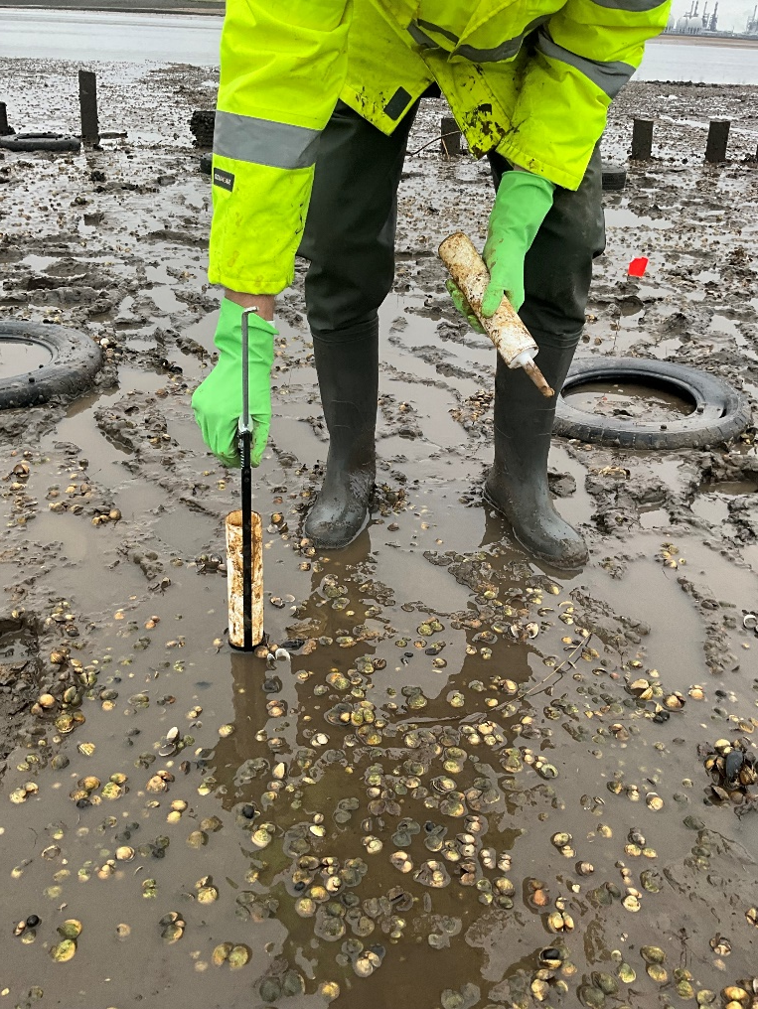
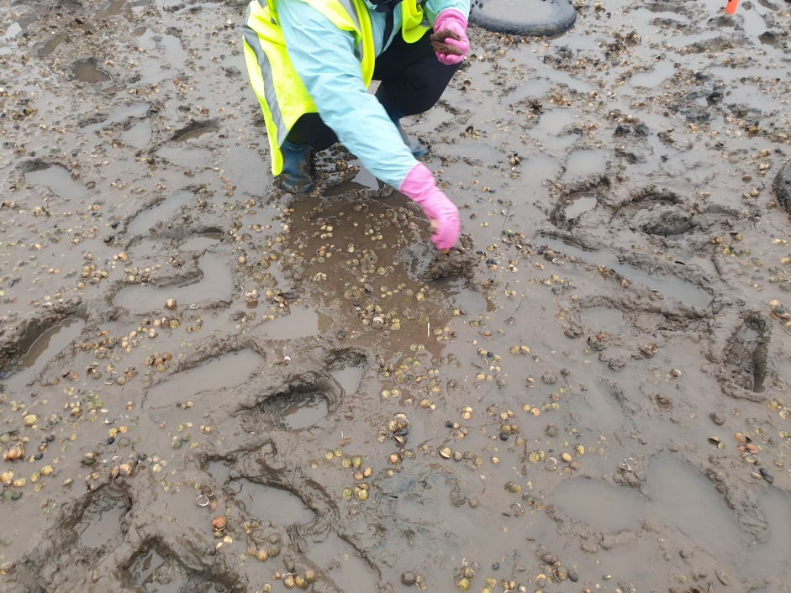
Seagrass babies
In 2023 we had the first flowering seagrass nursery plants
Babies from babies….
Trial planting 2024
Seedbags
Injection
Seedlings

Slide 10
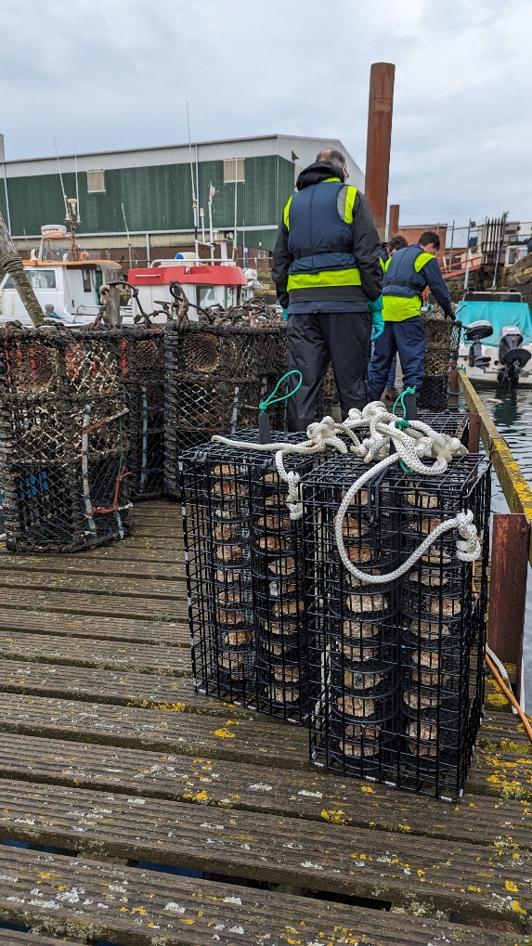
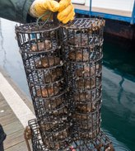
Native Oyster Nurseries
2 nurseries now installed around the Tees
Spatting pond trials this year to produce “Spat on Shell”
95% survival in Nursery no 1
>30 species found in the cages so far
Shortlisting in-shore locations for reef creation

Slide 11
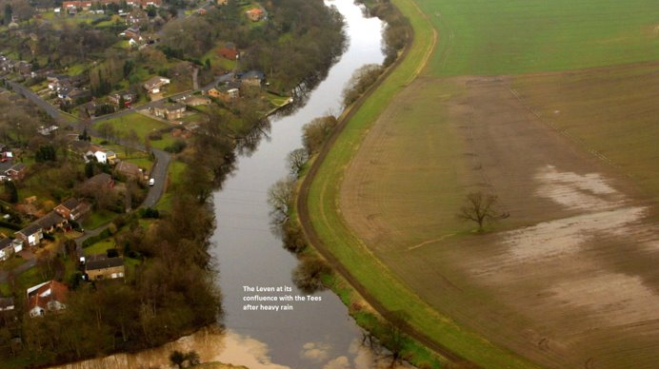
What have we learnt along the way?
Estuary restoration
MUST
be
catchment-wide

Slide 12
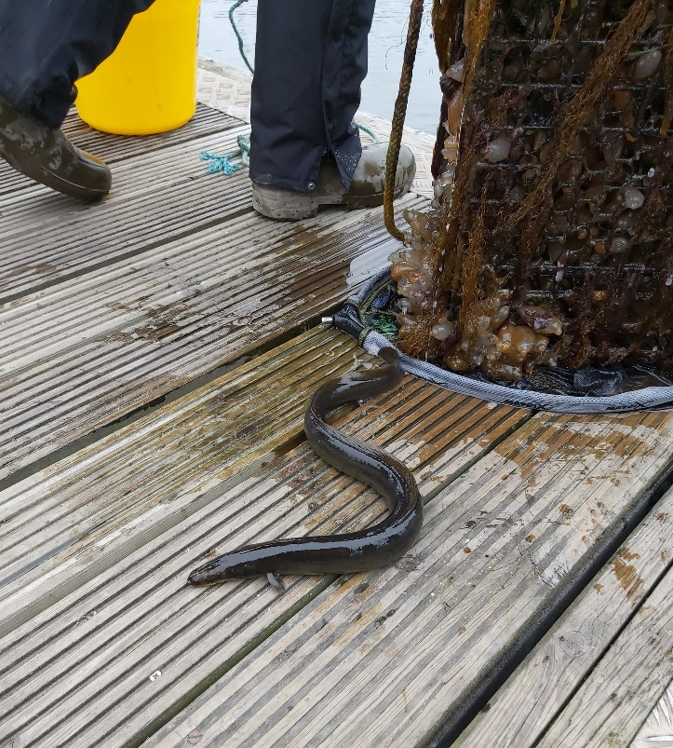
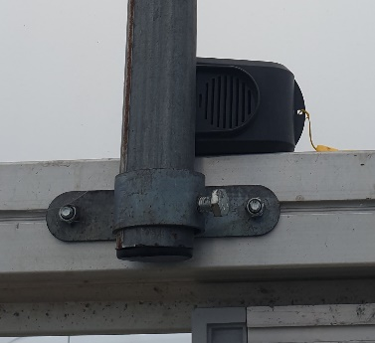
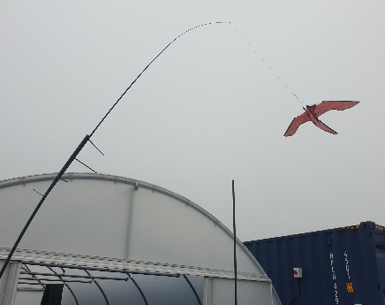
Nature somehow always does what it wants
Plants raised in artificial conditions flower and seed at the same time as in natural conditions
Biodiversity increases in the most unlikely places
Gulls v. Man – round 4 …………

Slide 13
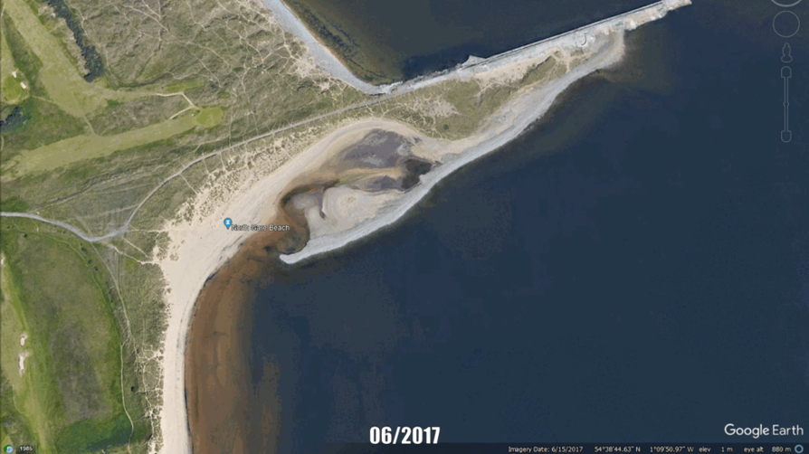
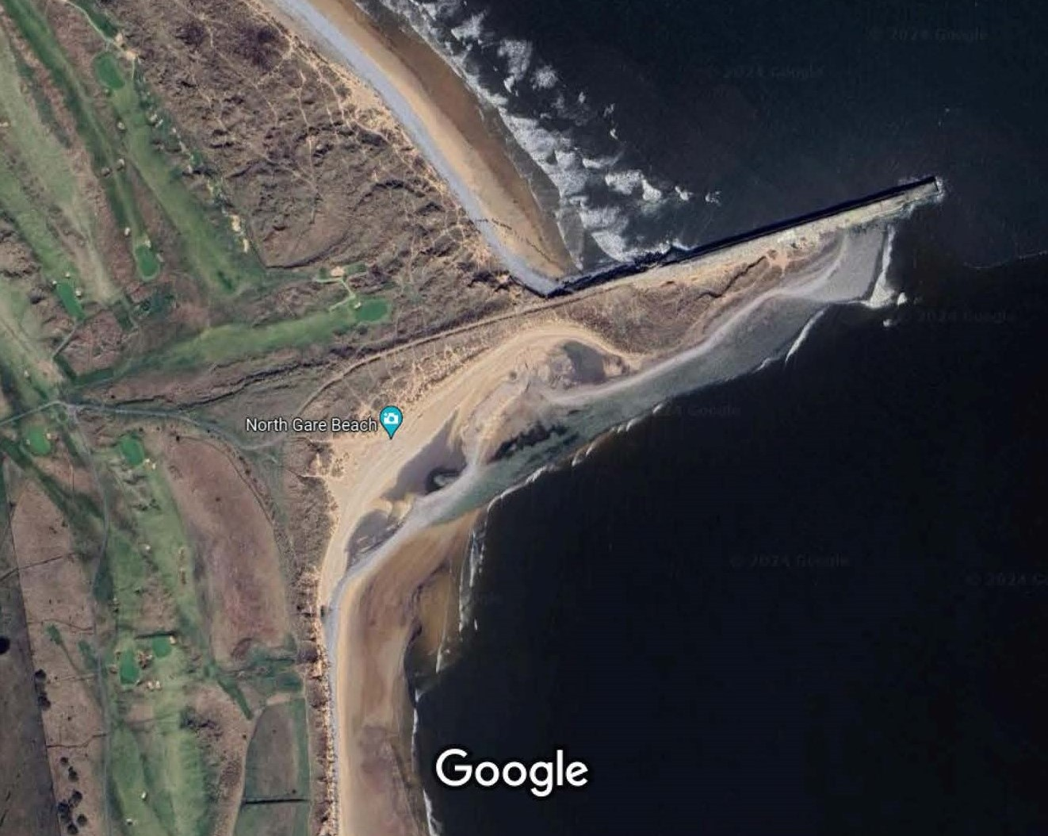
Some things you can’t plan for…

Slide 14
What else did we learn?
It’s not easy to shoehorn nature restoration into man made timeframes and regulatory frameworks

Slide 15
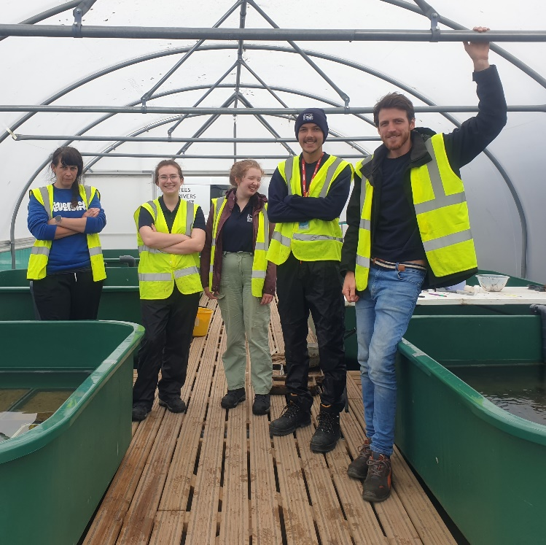
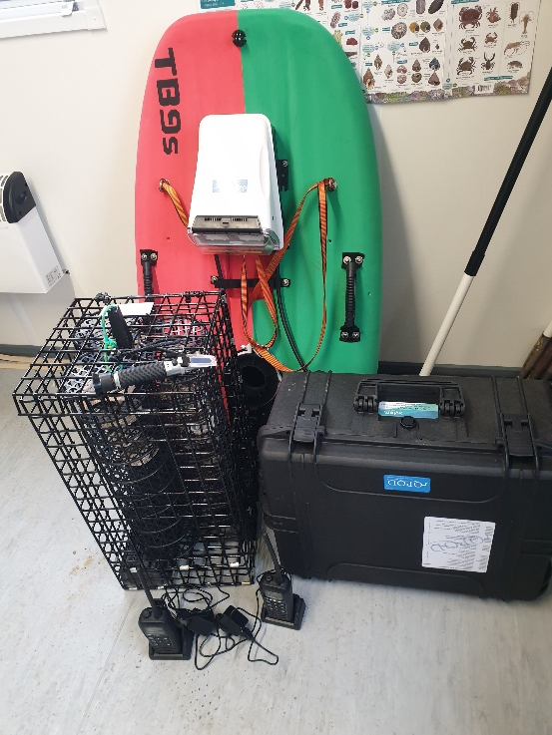
What else did we learn?
Funding
Working on long term projects with short term funding
How to make images of mud sexy
Not staff but stuff

Slide 16
What else did we learn?
Regulation is not always ready for restoration
Vast number of licences and consents needed to do the job annually
Crown Estate licences, Natural England consents to collect spathes, Natural England consents to survey and monitor sites, Natural England consents to plant seagrass, MMO licences, WFD assessments, NIFCA permits
Cost of the paperwork = £5,749 just this year
Processing time for paperwork…… >12 months
AND…
having to mitigate the mitigation………

Slide 17
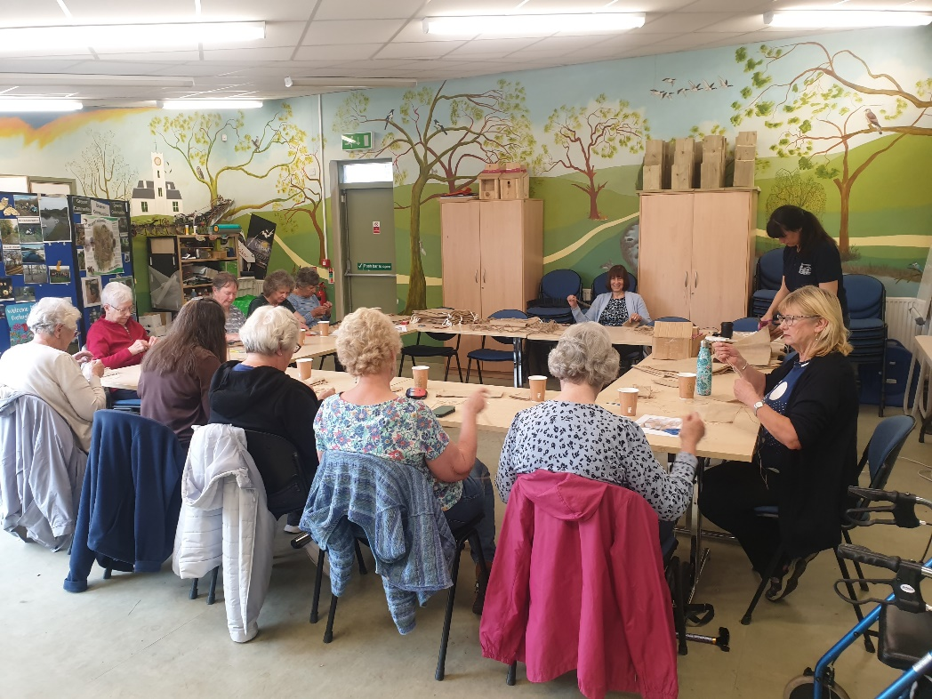
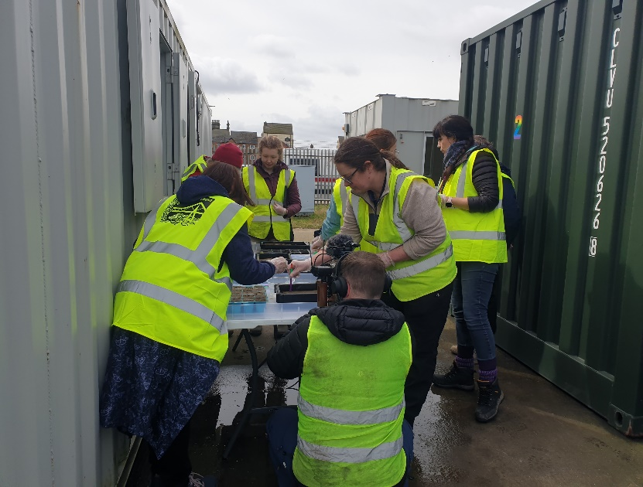
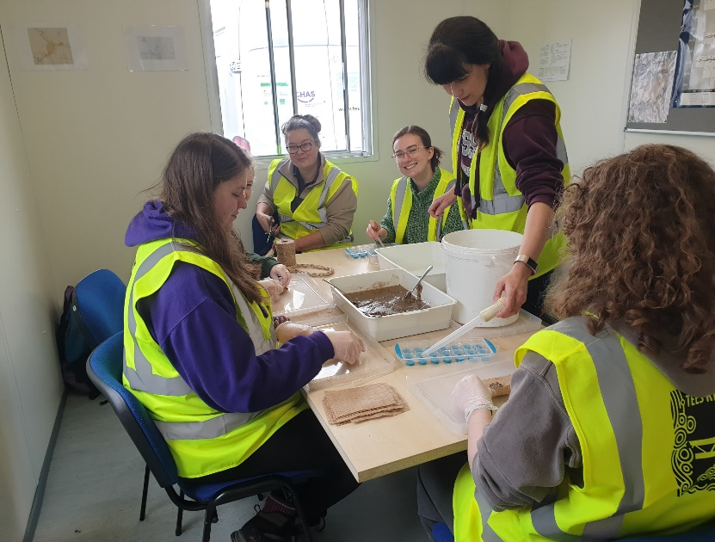
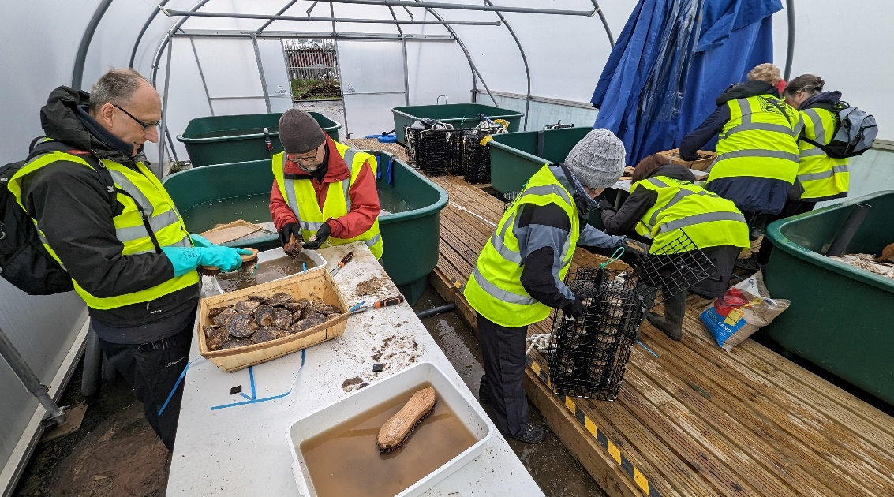
And finally….
Never ever underestimate the power of volunteers
or the WI……!

Slide 18
For more information…

