Slide 1
Marine habitats - a nature positive solution to shore protection
Alex Wickenden, Jack Duffy and Robyn Mastin-Wynne
Supervisors: Prof. Clare Fitzsimmons, Dr Heather Sugden and Prof. Pip Moore
Notes:
alph order

Slide 2
Introduction
There is an increasing threat of erosion, sea level rise and flooding along coastlines globally.
Natural habitats such as kelp forests, seagrass meadows and oyster reefs, by attenuating incoming wave energy, can reduce erosion and provide a nature positive solution to coastal protection.
Christianen et al., 2013; Hansen, 2013; McGlathery et al., 2013; Morris et al., 2018; Nyström et al., 2012

Slide 3
Research Importance
There is some debate as to how much wave energy these habitats attenuate.
Climate change is leading to increased storm intensity and frequency making coastlines and communities more vulnerable.
Improved understanding of nature-based solutions for coastal protection is crucial for stabilising our shorelines into the future.
Manis et al., 2015; Spalding et al., 2014

Slide 4
PhD 1- Remote sensing methods for monitoring habitat restoration

Slide 5
Aims
To develop novel remote sensing techniques to monitor marine habitat restoration in British waters
To relate output maps to biodiversity and/or ecosystem services

Slide 6
Current Goals
What, where, and when?

Slide 7
PhD 2- Understanding wave attenuation using wave tanks, artificial mimics and modelling

Slide 8
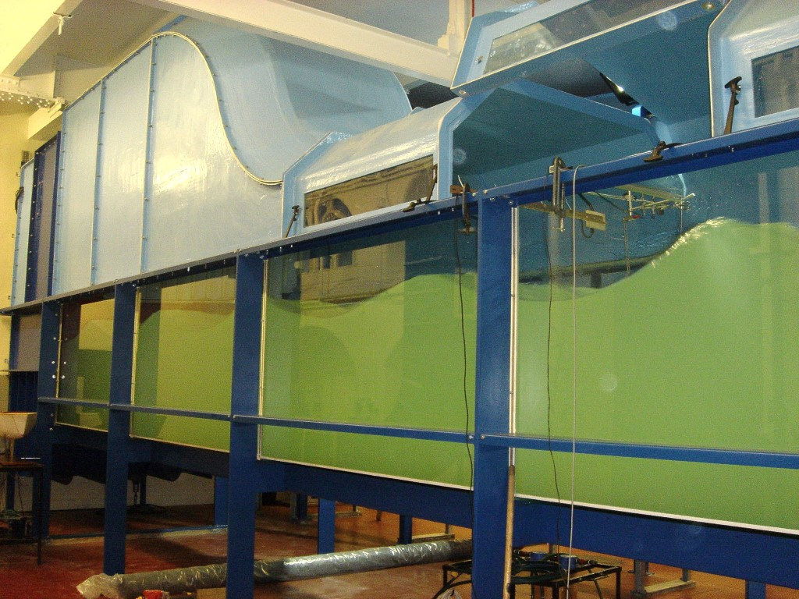
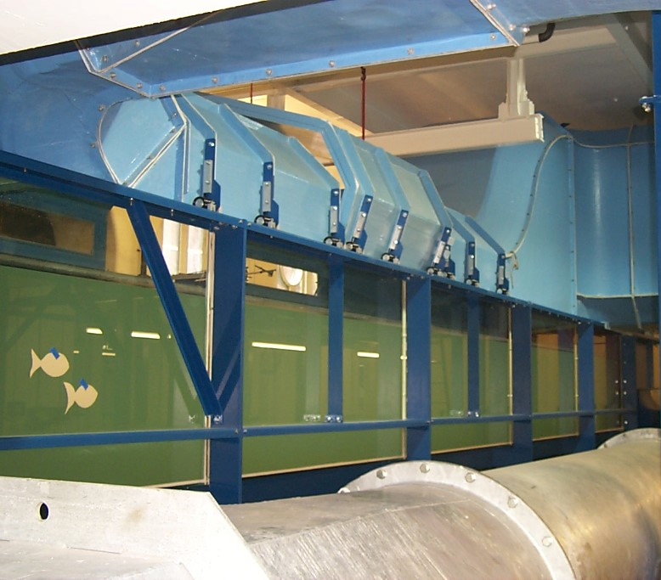

Slide 9
Aims
Understand the wave attenuation effects of seagrass, oysters and kelp using scaled mimics in wave tank experiments
Determine the optimal habitat restoration density - maximise wave attenuation, minimise cost
Assess the wave attenuation performance of these habitats under future IPCC climate scenarios

Slide 10
PhD 3- In-situ experiments to establish the role that UK kelp forests play in attenuating wave energy
Wave attenuation
Wave
propagation
Offshore
Onshore
Notes:
make aims like Jack and Alex

Slide 11
Aims
Test feasibility of using a low-cost device called a ‘mini buoy’ to determine wave attenuation provided by kelp forests.
Determine the amount of wave energy attenuated based on the areal extent, density, and morphology of kelp.
Investigate the development of novel techniques for restoring kelp on exposed coastlines.
Balke et al., 2021

Slide 12
Methods
Mini
buoy
Bottom Pressure Recording (BPR)
Falcon tube
Acceleration
data logger
Acoustic doppler current profiler (ADCP)
Weighted frame
Seafloor
Balke et al., 2021

Slide 13
Wave attenuation
Wave propagation
Offshore
Onshore

Slide 14
PhD 1- Remote sensing
Nature based toolkit for coastal protection
PhD 2- Hydrodynamic modelling
PhD 3-
In-situ experiments
Notes:
1.7.2013
link phds
one big arrow out of phd - toolkits, models etc..
‹#›

Slide 15
Thank you for listening
r.mastin-wynne@newcastle.ac.uk
j.duffy4@newcastle.ac.uk
a.wickenden2@newcastle.ac.uk

Slide 16
References
Balke, T., Vovides, A., Schwarz, C., Chmura, G.L., Ladd, C. and Basyuni, M., 2021. Monitoring tidal hydrology in coastal wetlands with the “Mini Buoy”: applications for mangrove restoration. Hydrology and Earth System Sciences, 25(3), pp.1229-1244.
Christianen, M.J., van Belzen, J., Herman, P.M., van Katwijk, M.M., Lamers, L.P., van Leent, P.J. and Bouma, T.J., 2013. Low-canopy seagrass beds still provide important coastal protection services. PloS one, 8(5), p.e62413.
Hansen, J.C., 2013. The effects of waves and turbulence on sediment suspension and mixing within seagrass ecosystems. University of Virginia.
Manis, J.E., Garvis, S.K., Jachec, S.M. and Walters, L.J., 2015. Wave attenuation experiments over living shorelines over time: a wave tank study to assess recreational boating pressures. Journal of coastal conservation, 19, pp.1-11.
McGlathery, K.J., Reidenbach, M.A., D'ODORICO, P.A.O.L.O., Fagherazzi, S., Pace, M.L. and Porter, J.H., 2013. Nonlinear dynamics and alternative stable states in shallow coastal systems. Oceanography, 26(3), pp.220-231.
Morris, R.L., Konlechner, T.M., Ghisalberti, M. and Swearer, S.E., 2018. From grey to green: Efficacy of eco‐engineering solutions for nature‐based coastal defence. Global change biology, 24(5), pp.1827-1842.
Nyström, M., Norström, A.V., Blenckner, T., de la Torre-Castro, M., Eklöf, J.S., Folke, C., Österblom, H., Steneck, R.S., Thyresson, M. and Troell, M., 2012. Confronting feedbacks of degraded marine ecosystems. Ecosystems, 15, pp.695-710.
Spalding, M.D., Ruffo, S., Lacambra, C., Meliane, I., Hale, L.Z., Shepard, C.C. and Beck, M.W., 2014. The role of ecosystems in coastal protection: Adapting to climate change and coastal hazards. Ocean & Coastal Management, 90, pp.50-57.

