Slide 1



Seagrass and seaweed – a future for coastal resilience
Small-scale trials to explore future restoration and aquaculture scenarios
Martina Bristow
Seagrass and Seaweed Research Officer, Durham Wildlife Trust
Notes:
Hello, I’m Martina and I work for the DWT on a SS project that looks at how seagrass and seaweed could enhance coastal resilience in the North East.
My role is technical lead on this project – fieldwork and data analysis– but JW and MD from the Lincolnshire and Durham WTs respectively deserve a special mention for the work they have and continue to put in to this project.

Slide 2
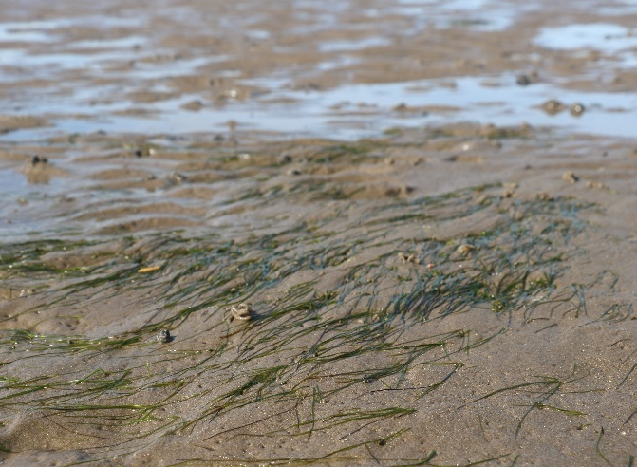
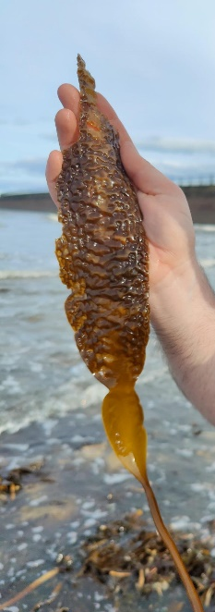
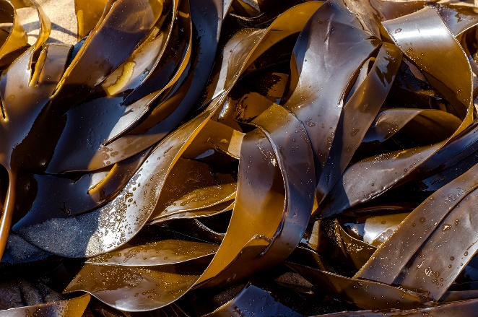
Seagrass
Credit: Richard Unsworth
Aims
Methods
Sites
Timeline & Progress
Dwarf eelgrass (Zostera noltii)
Seaweed
Oarweed (Laminaria digitata)
Sugar kelp (Saccharina latissima)
Notes:
This project is made up of two sub-projects: one looks at the feasibility of restoring dwarf eelgrass – the smaller of the two Zostera species of seagrass in the UK; and one which looks to understand how the cultivation of kelp seaweeds – oarweed and sugar kelp – could help attenuate waves and protect the coast.
*For each of these sub-projects I’ll talk you through our aims, methods, the sites we’ll be considering, and give you a picture where we’re currently at and what we have upcoming.

Slide 3
Credit: Richard Unsworth
Notes:
First, our seagrass work…

Slide 4
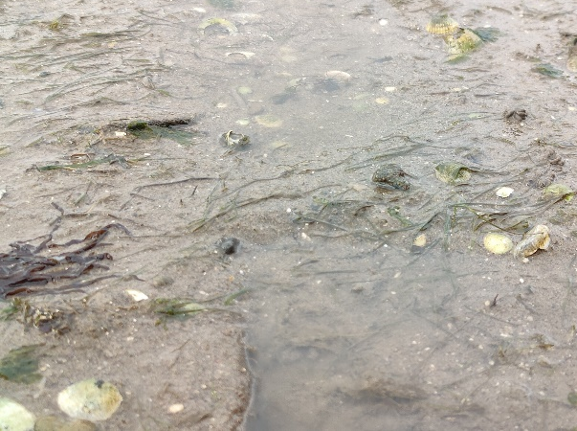
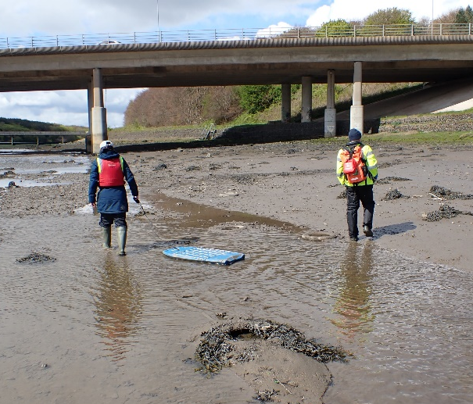
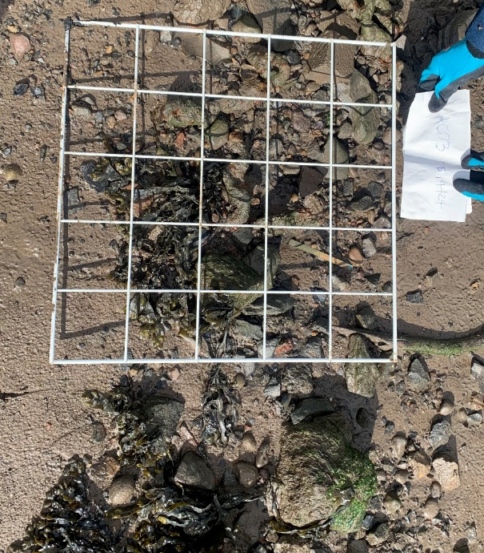
Seagrass: Aims
Feasibility of reintroducing seagrass in the North East
Assess current distributions at 5 coastal rivers & estuaries
Pilot reintroduction trials in optimum sites
Identify important environmental factors
Model for a local restoration pipeline
Determine habitat suitability for potential future restoration
Notes:
One of our main aims is to assess the feasibility of reintroducing seagrass in the region. To start, we’ll look at whether there is any seagrass present at 5 candidate sites, choosing 3 of these sites to run small-scale trials.
These trials will help us to identify what makes for a good environment for seagrass, and help us develop a model for future restoration that capitalises on local resources and local capability.
Our results will feed into a desk-based feasibility study that covers the broader North East region.
Once we have an idea of where suitable seagrass habitat is located, then together with the fact that we’ve tried and tested small-scale reintroductions with our local partners, we’ll be in a state of technical readiness for any future upscaling of restoration efforts in the region.

Slide 5
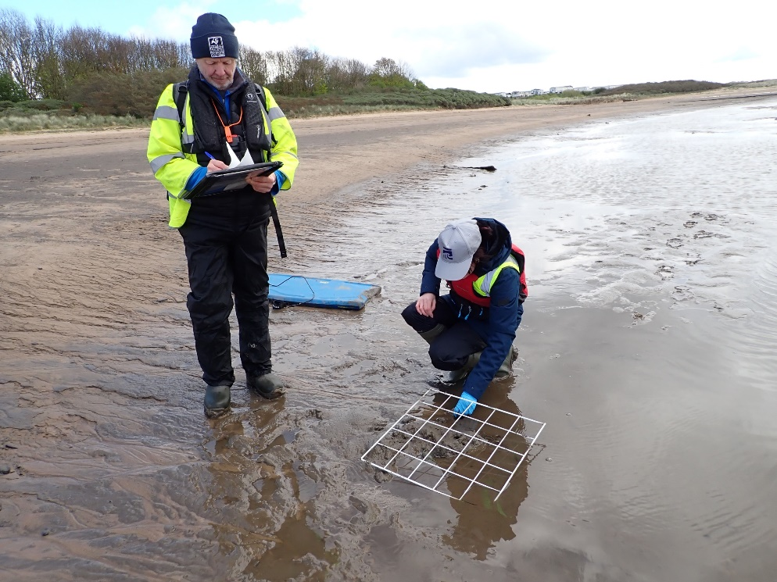
Seagrass: Methods
Pilot reintroductions
Install 1m² gridded frames
Plant seedlings in frame, monitor growth
Characterise environment at each site
Seedlings grown by Tees Rivers Trust
    ~ acclimatise to conditions at planting site
Notes:
Our pilot trials are small-scale as we’ll only be planting 300 seeds at each site. Without the support of an established seagrass meadow, small patches of young seagrass is at risk of getting washed away, so to address this we’ll be planting the seedlings in 1m by 1m gridded frames to help protect them. *We can also attach sensors to the frames, allowing us to leave our sensors out for a tidal cycle without them getting washed away or sinking into the mud.
The seedlings we’ll plant will be grown by our lovely partners at the Tees Rivers Trust who have a dedicated seagrass nursery at the Hartlepool docks. Their nursery system is able to modify growing conditions so together we’ll test to see whether acclimatising the plants to conditions they’ll eventually encounter makes a difference to how they do once planted out. We’ll also test whether sediment taken from our field sites is a suitable growing medium and leads to better establishment success in the wild.

Slide 6
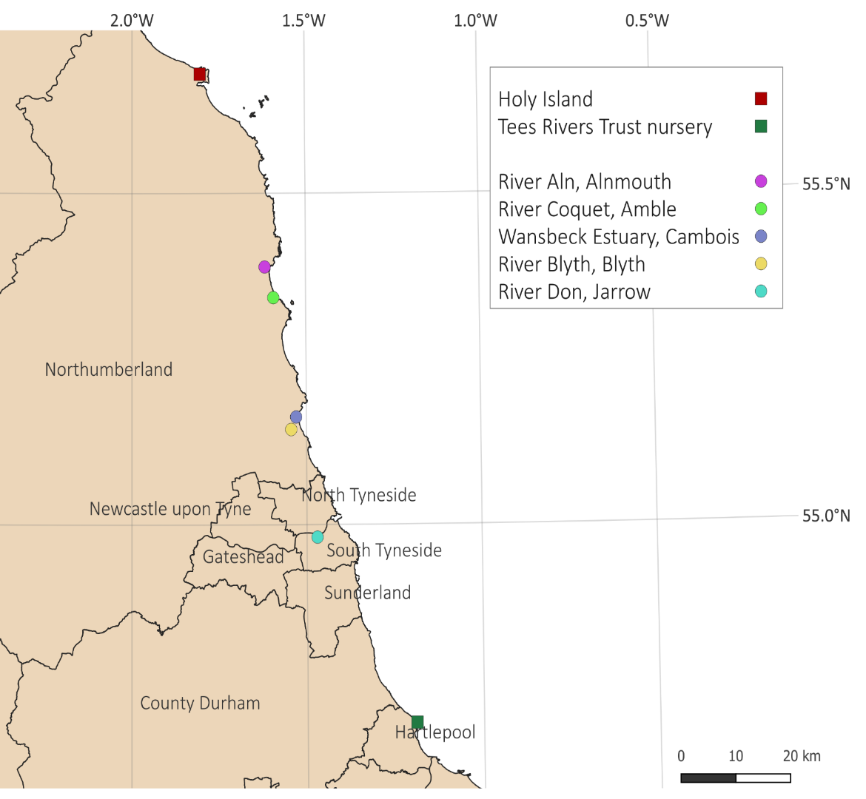
Seagrass: Sites
Five sites along Northumberland
and Tyneside coast
Records of seagrass / associated birds
Intertidal, sheltered locations
Protected & industrial areas
Notes:
Our 5 sites were chosen based on recent or historical records of either seagrass or seagrass-associated birds (such as Widgeon and Brant Geese) at sheltered, intertidal habitat that are potentially suitable for dwarf eelgrass.
The 5 sites are shown by the circles on the map here – most northerly is Alnmouth in purple, followed by Amble, Cambois, and Blyth in Northumberland, and Jarrow in South Tyneside (blue). For reference, you can also see where the Tees Rivers Trust nursery is based in Hartlepool, and Holy Island, up north, which has the region’s only extensive, established seagrass beds in this region.
The locations we chose have potentially different levels of human impact – some are in areas under conservation protection, such as important mudflat habitats, and some are in industrial areas or places where recreational activities take place.

Slide 7
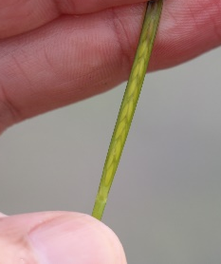
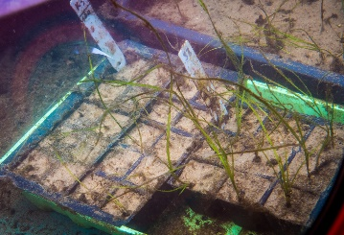
Seagrass: Timeline & Progress
(Spring & Summer 2024)
Walkover surveys of 5x sites
Monthly environmental monitoring
+ seagrass growth
Install frames at 3x sites
Plant out seedlings
(Spring 2025)
(Summer 2024)
Remove frames
(Autumn/Winter 2024)
(Spring and Summer 2025)
(Summer 2026)
Collect & grow seed
Walkover surveys of
5x sites (2025)
Credit: Richard Unsworth
Credit: Tees Rivers Trust
Analyse data feed learning into toolkit and develop feasibility study
Notes:
Since I started in January*, we’ve been undertaking the first set of walkover surveys to look for seagrass. Our next step is to choose three of these sites and install the frames* to begin our monitoring.
Dwarf eelgrass begins to seed in late summer, so during the autumn we’ll collect seed* from a donor bed and together with Tees Rivers Trust grow them over winter, ready to plant out by next spring. Next year we’ll continue monitoring how well the seagrass is growing*, and we’ll undertake repeat walkover surveys at all five of the sites.
All the while*, we’ll be analysing the data we get and feeding important lessons, ideas, and results in to the Stronger Shores toolkit, and also developing a feasibility study applicable to the wider North East coastal region. *Finally, at the end of this project we’ll remove the frames and seagrass along with it.

Slide 8
Notes:
Now to take a look at the seaweed part of the project:
There’s mounting evidence that kelp forests can help protect our coasts by reducing energy in waves… and hear more about exciting research into natural kelp forests later this morning.
However - given that seaweed aquaculture is an up-and-coming industry – can cultivated seaweed help protect our coastlines as well?

Slide 9
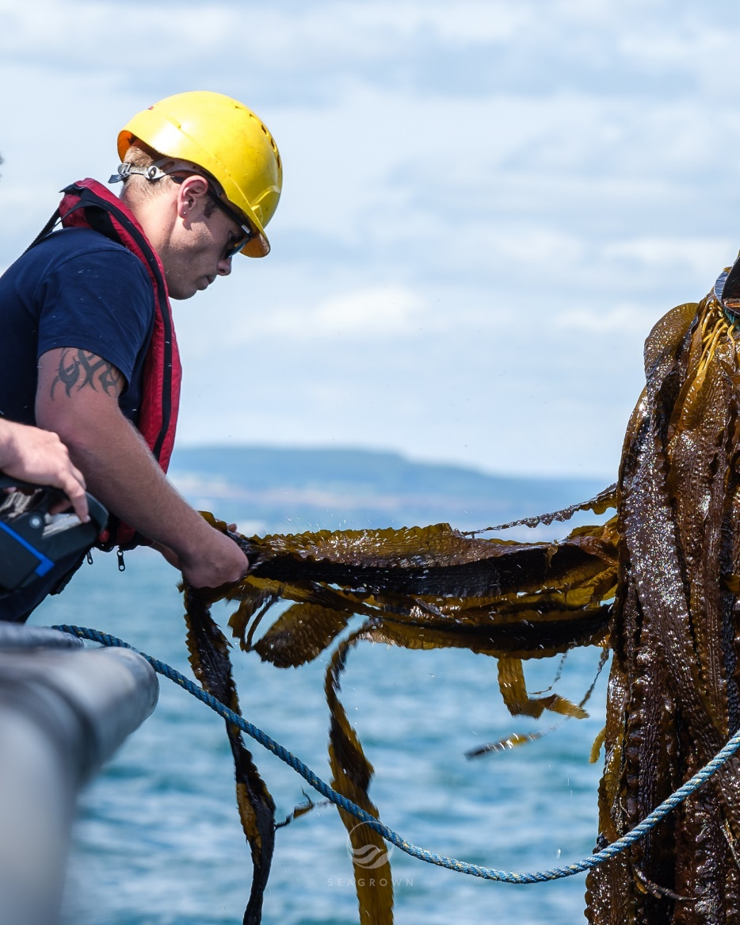
Seaweed: Aims
Investigate protection benefits of seaweed aquaculture
Ability to reduce wave action¹
Biodiversity enhancement
Differences due to species and growing regimes
Credit: SeaGrown. Image not for wider circulation
¹ Dong et al., 2024
Notes:
We know that vegetation is effective at dampening wave energy when the top of the canopy is near the surface of the water, so, in deeper waters where wild kelp might not be able to grow or have little impact on the waves, suspended kelp farms could provide an alternative nature-based solution.
Some recent work by Dong et al. suggests that suspended kelp farms could reduce wave height by over 50% under some conditions, and found that the species and way its grown influence how effective these farms are.
In light of this, we’ll be investigating how cultivated seaweed can reduce water motion and enhance biodiversity.

Slide 10
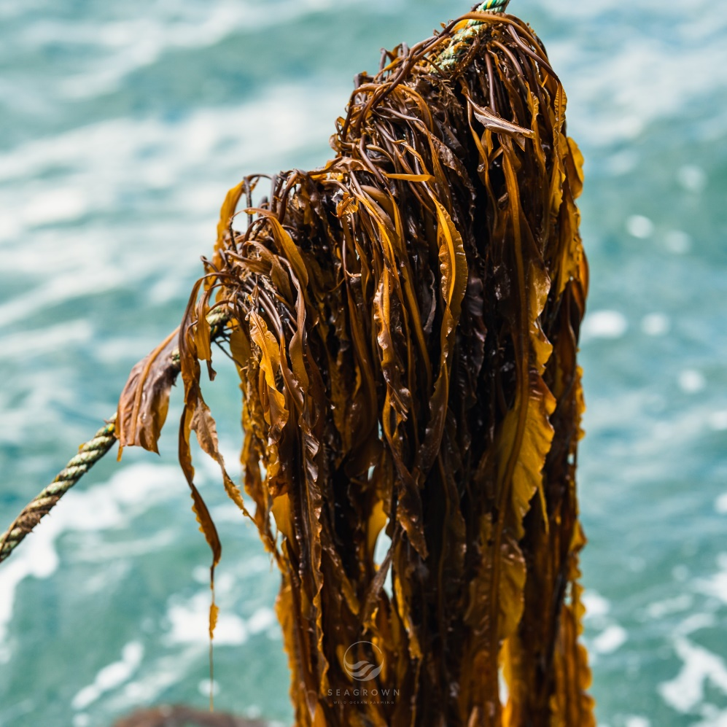
Seaweed: Methods
Small-scale seaweed sensor array at sea
Partnered with SeaGrown, Scarborough
12 KelpedoTM units equipped with sensors
Two local kelp species: Oarweed and Sugar Kelp
Growing regimes
  Regular (harvest) / Maximum gain / Unseeded lines
Credit: SeaGrown. Image not for wider circulation
Notes:
To do this, we’ve partnered with SeaGrown, an offshore seaweed company based in Scarborough, to install 12 of their Kelpedo seaweed units off the Durham coast.
We’ll seed these with locally collected oarweed and sugar kelp and equip them with various environmental sensors. Each month, we’ll visit the site to take growth measurements and record any epifauna and epiphytes found growing amongst the seaweed.
We’re going to test 3 different growing regimes, one where seaweed is grown and harvested at regular intervals as is standard for seaweed farming, one where we look at the maximum biodiversity gain by allowing the seaweed to grow without cutting it back, and finally one where we deploy unseeded lines and look to see what species present in the water settle and start to grow on the units.
[Stress not setting up a seaweed farm – scientific sensor array and not harvesting/selling any products, and our site is much smaller than a typical seaweed farm.]

Slide 11
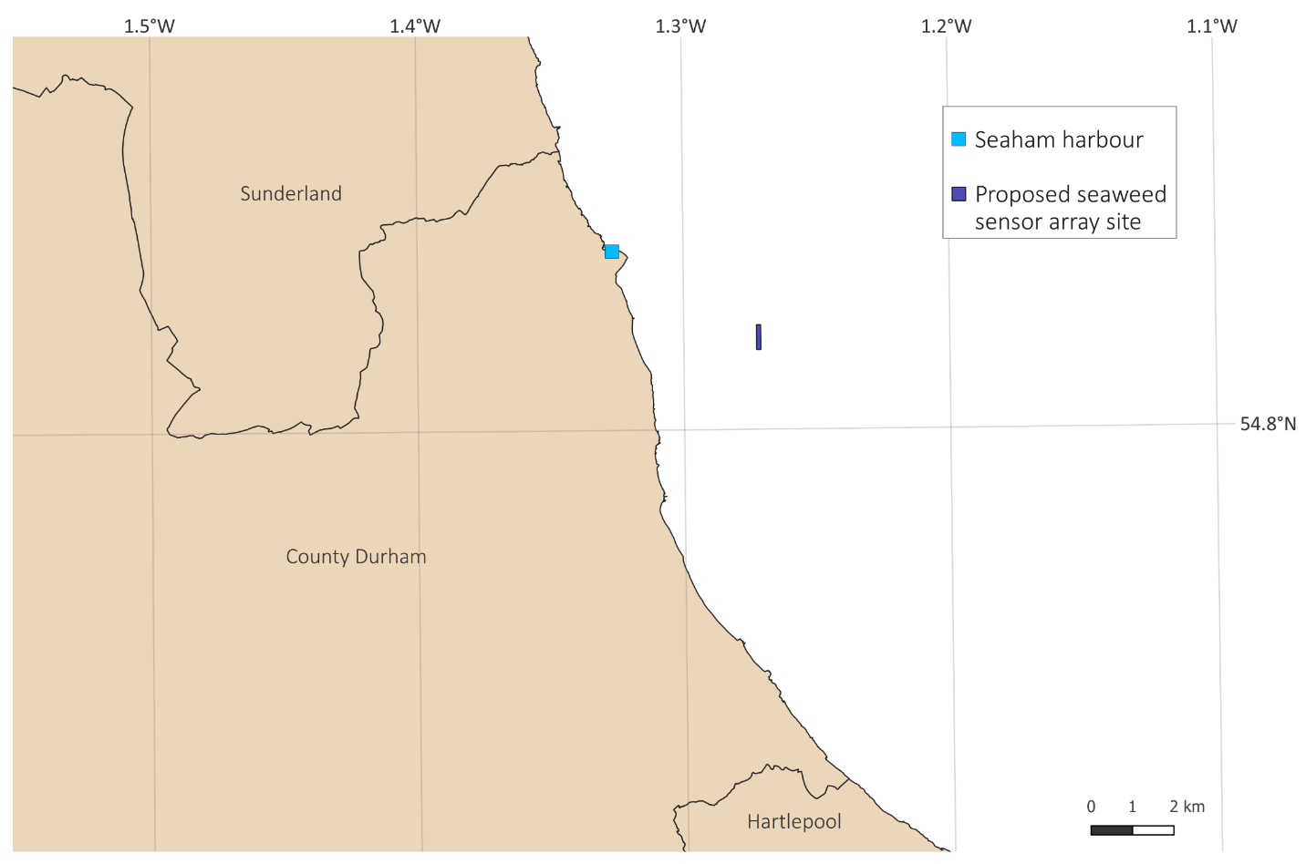
Seaweed: Site
Proposed sensor array site 3 km off Durham coast *
* Subject to MMO licensing
Units spaced by 50m
1m² footprint each
Monitored monthly by charter workboat
operating out of Seaham harbour
Notes:
Subject to licensing, our site will be located about 3 km off the Durham coast, east of Hawthorn Hive – here on the map (dark blue rectangle).
The 12 units will be arranged in a N-S orientation over 600m, such that each unit is 50m apart. The units themselves are not longlines, which are commonly used in seaweed farms, but are compact units moored to the seabed with a footprint of only 1m² both at the seabed and at the surface.
I’ll be heading out each month to service the equipment and take measurements from a boat operating out of Seaham harbour, shown on the map here (light blue square). Trai will also join us on some of these trips to get footage of what we’re doing out there.

Slide 12
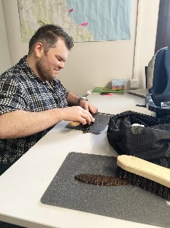
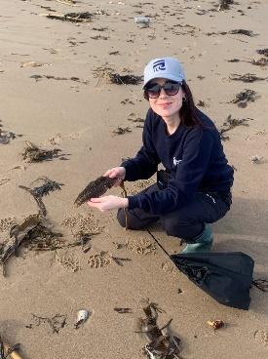


Seaweed: Timeline and Progress
Monthly monitoring / data downloads
+ seaweed biometrics
Collect sugar kelp sori
Install oarweed
KelpedoTM units
(Summer 2024)
(Winter 2024)
Install KelpedoTM units
Collect
oarweed sori
Apply for
MMO licence
(Autumn 2024)
Decommission / Community takeover
(Spring 2024)
(Summer 2026)
Image not for wider circulation.
Analyse data contribute learning to Stronger Shores toolkit
Notes:
This year so far*, James has been busy with our licence application – we’re tentatively hopeful that we’ll have a licence granted by June.
I’ve been out with Blair to collect sugar kelp sori – this is the fertile part of sugar kelp which SeaGrown then cultivate to produce seeded lines. Sadly our first batch failed, nevertheless* we aim to install the first set of Kelpedo units out at sea this summer.
Later this year*, oarweed will become fertile so we’ll be back out again collecting more sori. SeaGrown will cultivate this* and we’ll put out the oarweed Kelpedo units this winter.
*As before, our analyses and experience will feed into the Stronger Shores toolkit.
Finally*, at the end of the project the units will either be decommissioned or passed over to the local community.

Slide 13
Thanks!
Warkworth Harbour Commissioners
Marine Management Organisation
Natural England
Project Seagrass
Restoration Forth
Various Wildlife Trusts
Tees Rivers Trust
SeaGrown
Sunderland City Council
South Tyneside Council
Northumberland Estates
Northumberland County Council
References: Dong, G. H., Zhang, B., & Bi, C. W. (2024).
Numerical analysis on the wave attenuation characteristics of a suspended kelp farm. Ocean Engineering, 306, 118066.
Notes:
That concludes my talk. Thanks to all of our Stronger Shores partners - particularly TRT, SeaGrown, all the organisations that have allowed us to carry out our work, and given me advice and experience in the field.

