Slide 1
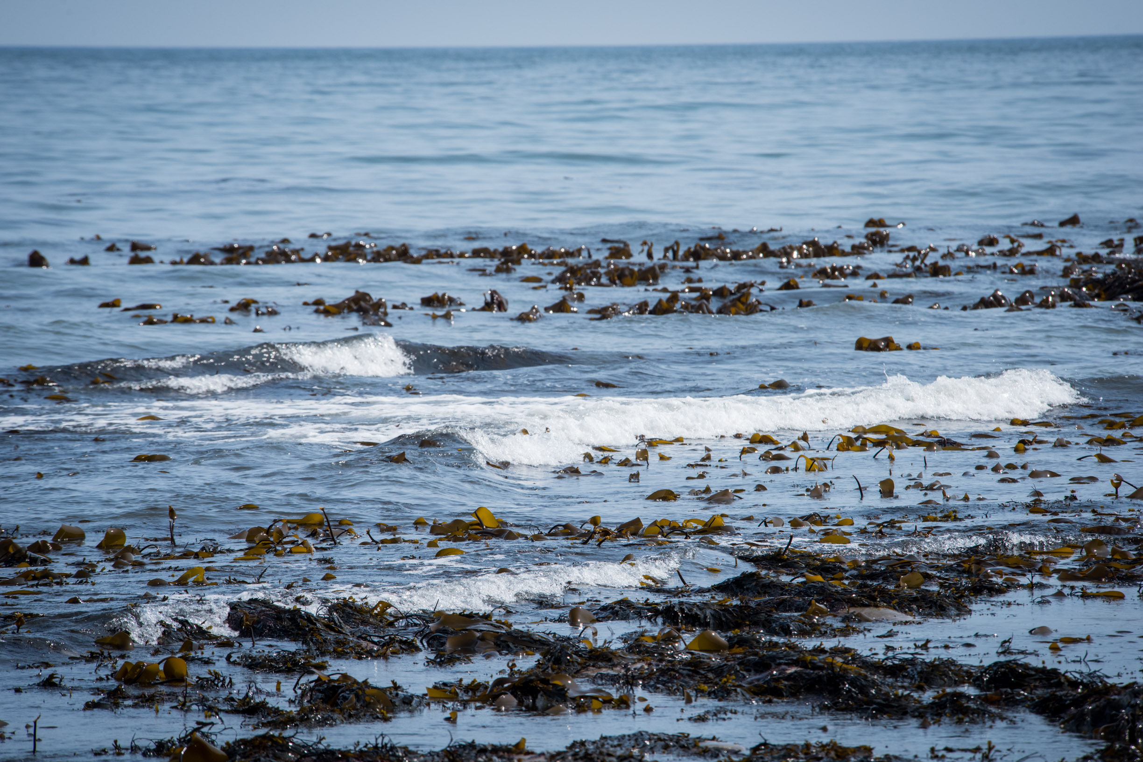
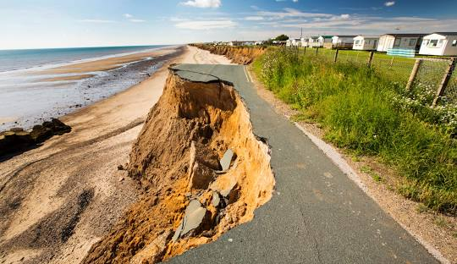
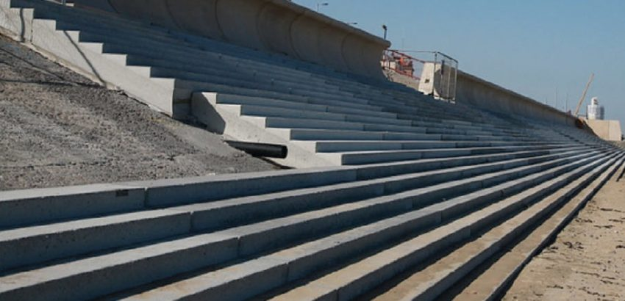
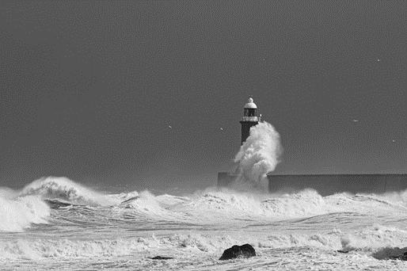
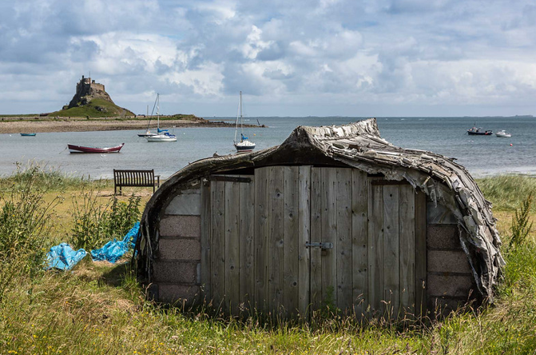
Stronger Shores: Marine Nature Based Solutions and Natural Capital in Flood and Coastal Erosion Risk Management
Matt Ashley, Tom Mullier, Riley Bibaud, Helen Agosti, Siân Rees
UNIVERSITY OF PLYMOUTH
Notes:
Introduction to us

Slide 2
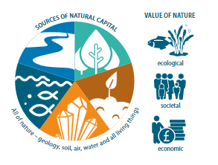
WHAT IS NATURAL CAPITAL?
Natural capital: The elements of nature that directly or indirectly produce value to people, including ecosystems, species, freshwater, land, minerals, the air and oceans, as well as natural processes and functions. (Natural Capital Committee 2017)
The Natural Capital Approach is central to the UK Government’s ambition to improve and restore nature.

Slide 4
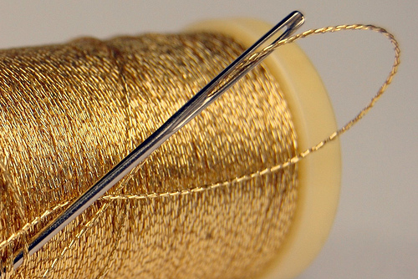
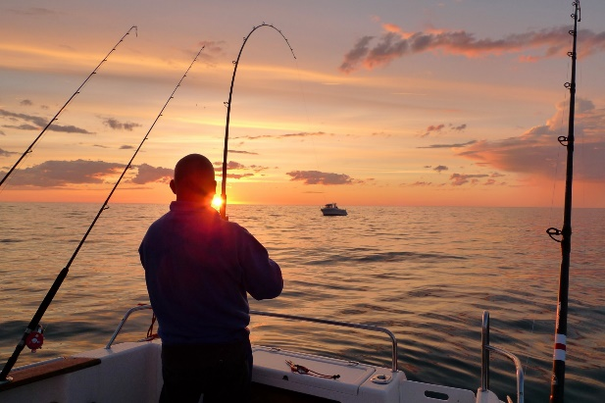
WHY TAKE A NATURAL CAPITAL APPROACH
The Earth’s ecosystems make life possible and worth living
Benefits for human well-being
e.g. food, health, and social benefits
Ecosystem services
e.g. clean water, fish, seals
Ecosystem functions and processes
e.g. primary production, formation of species habitat
Habitats , species and the physical environment
https://divebuddies4life.com/england-the-farne-islands-unleashed/

Slide 6
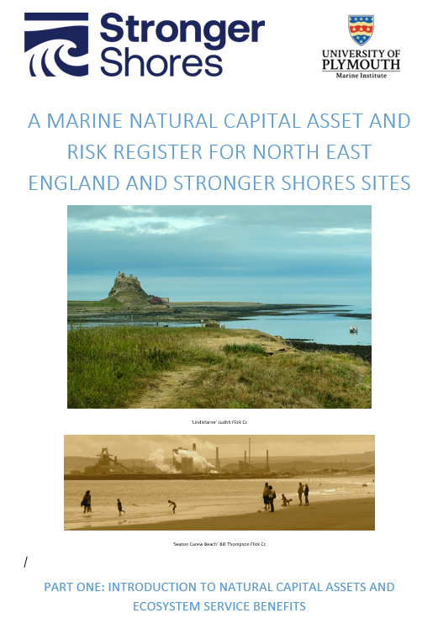
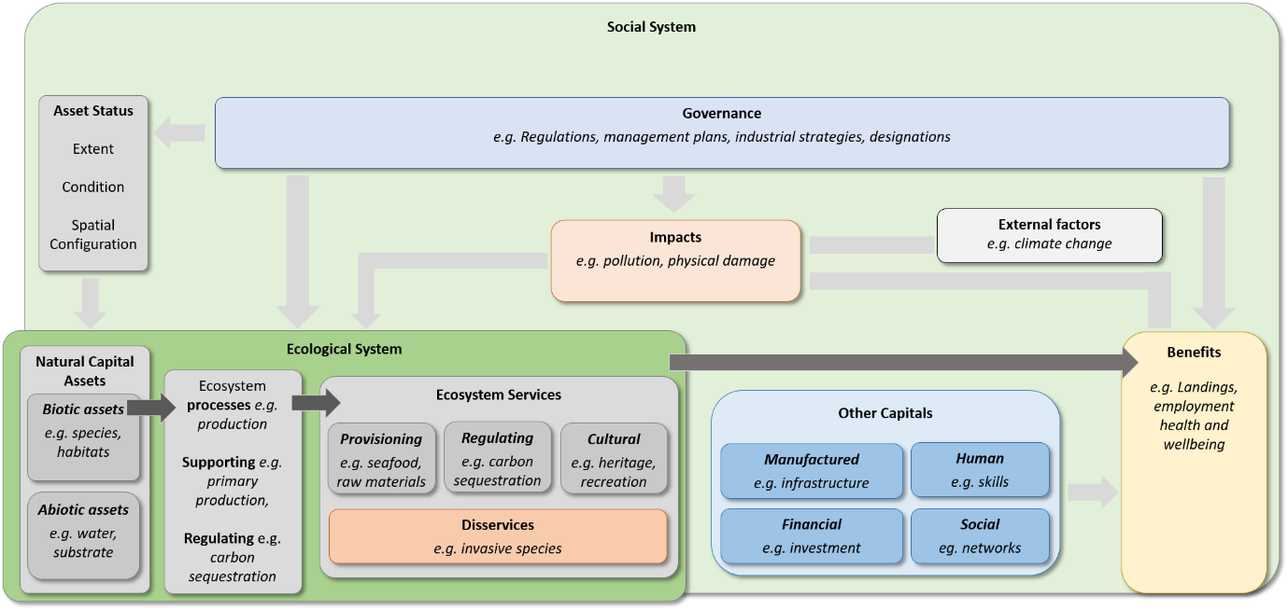
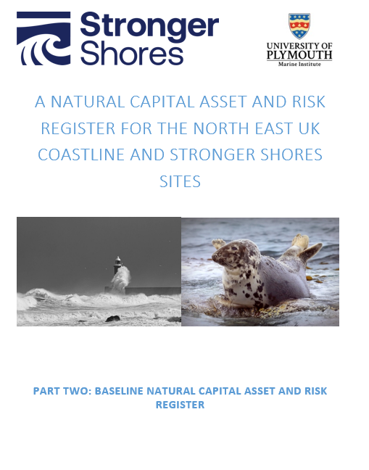
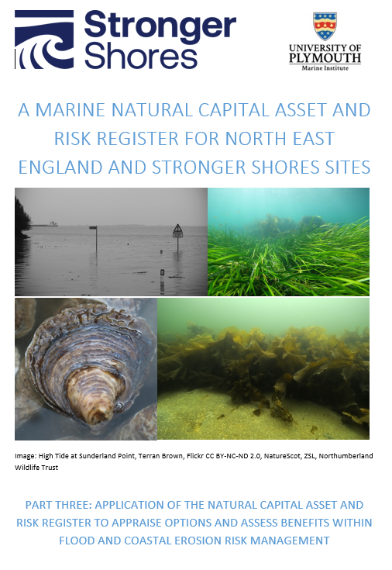
HOW TO CONCEPTUALISE A NATURAL CAPITAL APPROACH
Notes:
So returning to the concept of natural capital and how it fits with the discussion today – We work with the following definitions:
Natural capital: The elements of nature that directly or indirectly produce value to people, including ecosystems, species, freshwater, land, minerals, the air and oceans, as well as natural processes and functions.
Assets: a distinctive component of natural capital as determined by the functions it performs, e.g. habitats, species, waterbodies
Ecosystem services: Functions and products from nature that can be turned into benefits with varying degrees of human input.
Benefits: Changes in human welfare (or well-being) that result from the use or consumption of goods, or from the knowledge that something exists.
We recently adapted the Natural Capital Asset and Risk Register to provide an evidence base and identify implications of current and proposed actions within the Plymouth Sound and Estuaries SAC and inform development of Plymouth Sound National Marine Park.
This undertook a 3 stage process that we have adapted to Stronger Shores to provide an evidence base of the state and pressures on natural capital assets and linked ecosystem service benefits in the North East English Region and a baseline for the Stronger Shores sites. Followed by an assessment of the implications of proposed activities in Stronger Shores sites.
This approach is intended to provide evidence on the implications of nature based solutions for flood and coastal risk erosion, assessing potential changes from baseline conditions and taking a holistic view of benefits, including coastal and erosion benefits alongside the suite of ecosystem service benefits seagrass, native oyster and kelp habitats provide. The approach also enables identification of pressures on these habitats and the wider coastline that will limit potential for ecosystem service and benefit supply and management priority to reduce risk.
We have been working behind the scenes to develop the baseline tools/evidence to integrate a natural capital approach within the Stronger Shores project and wider Flood and Coastal Erosion Risk Management.
This is split across three work areas
Describing the ecosystem services linked to the assets of habitats, species and water bodies
Made use of the most up to date sources to provide evidence on the three important elements of asset status that are the basis of the ecosystem services and benefits derived and the risk posed to the availability of ecosystem services under current governance
3) Considered how current and future management in this area may change the both the asset status, the ecosystem services and the benefits derived.
In this 10 minutes we would like to take the opportunity to provide some high level findings and then work with you to integrate any aspects of this work (if useful) into your areas of work and delivery. We would be very happy to take the time to do this.

Slide 7
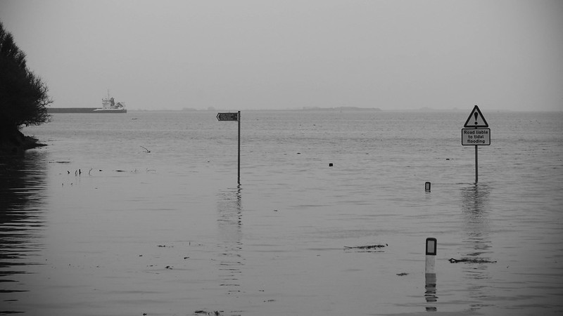
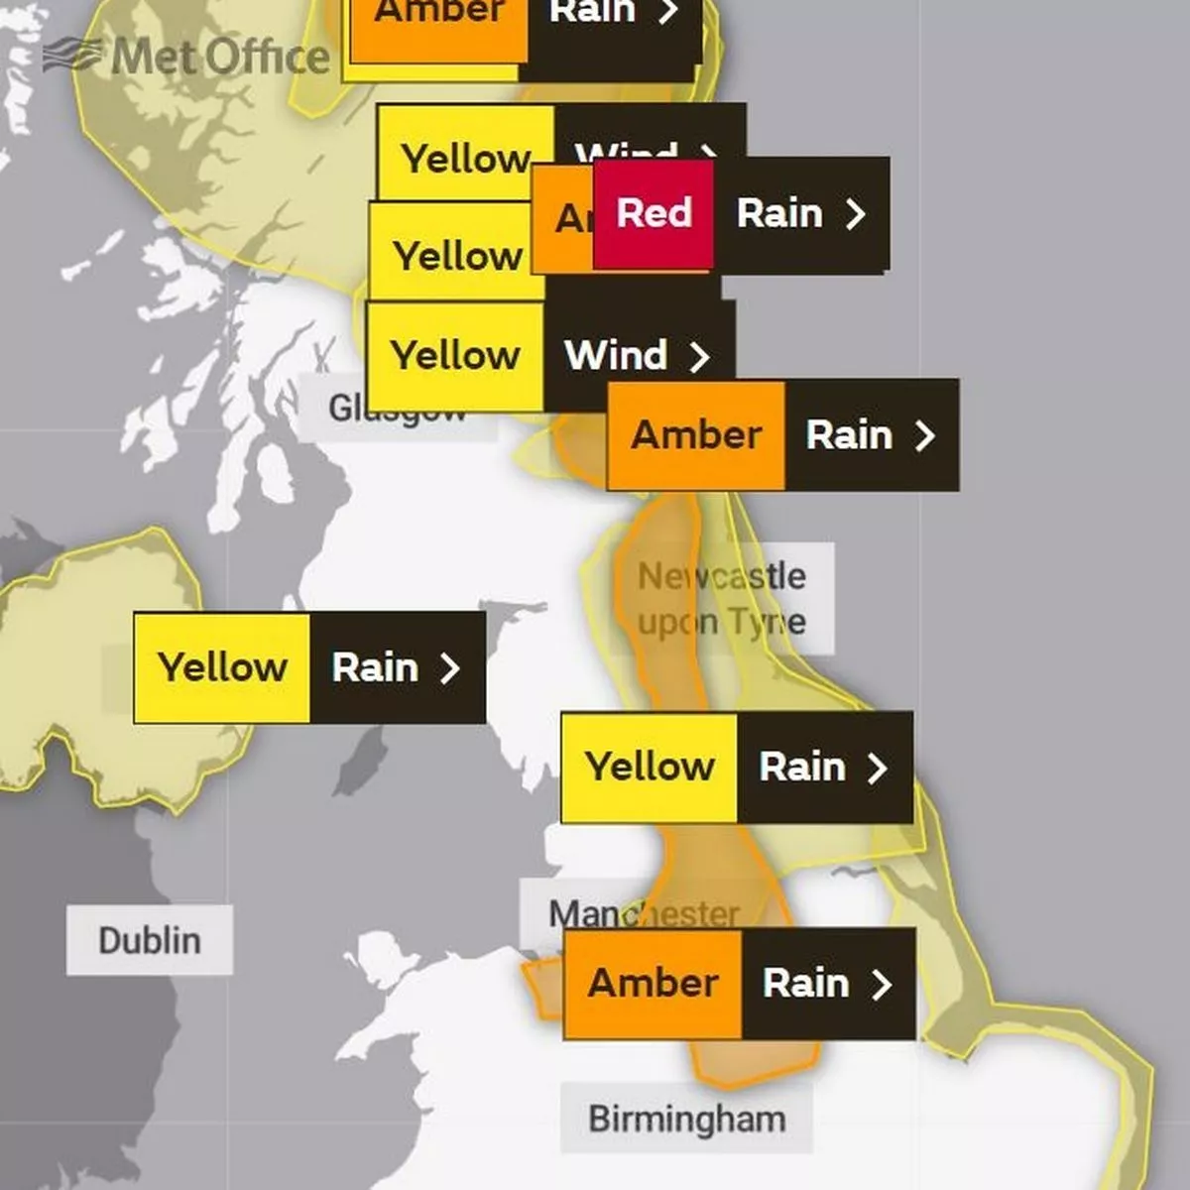
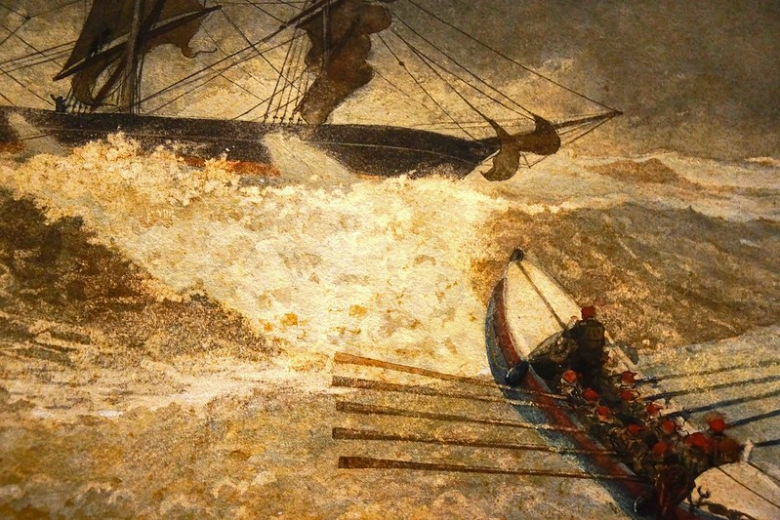
Flood and Coastal Erosion Risk Management (FCERM)
Natural Capital Asset and Risk Register outputs are intended to be accessible to risk management authorities (RMAs).
Inform RMAs when
‘Developing and Appraising Options’ &
‘Assessing and Valuing the Benefits’ from Nature based solutions within FCERM options.
Provide an approach for flood risk management authorities to follow when considering the role of marine nature-based solutions in future coastline management strategies, including improved integration of natural capital approaches.
Storm, Rob Donnelly; The Wreck of the Iron Crown TheMET(Ss) Regan Vercurysse. Flickr CC BY-NC-ND 2.0 Deed
High Tide at Sunderland Point, Terran Brown, Flickr CC BY-NC-ND 2.0 Deed; Met Office.
Notes:
The Stronger Shore context

Slide 8
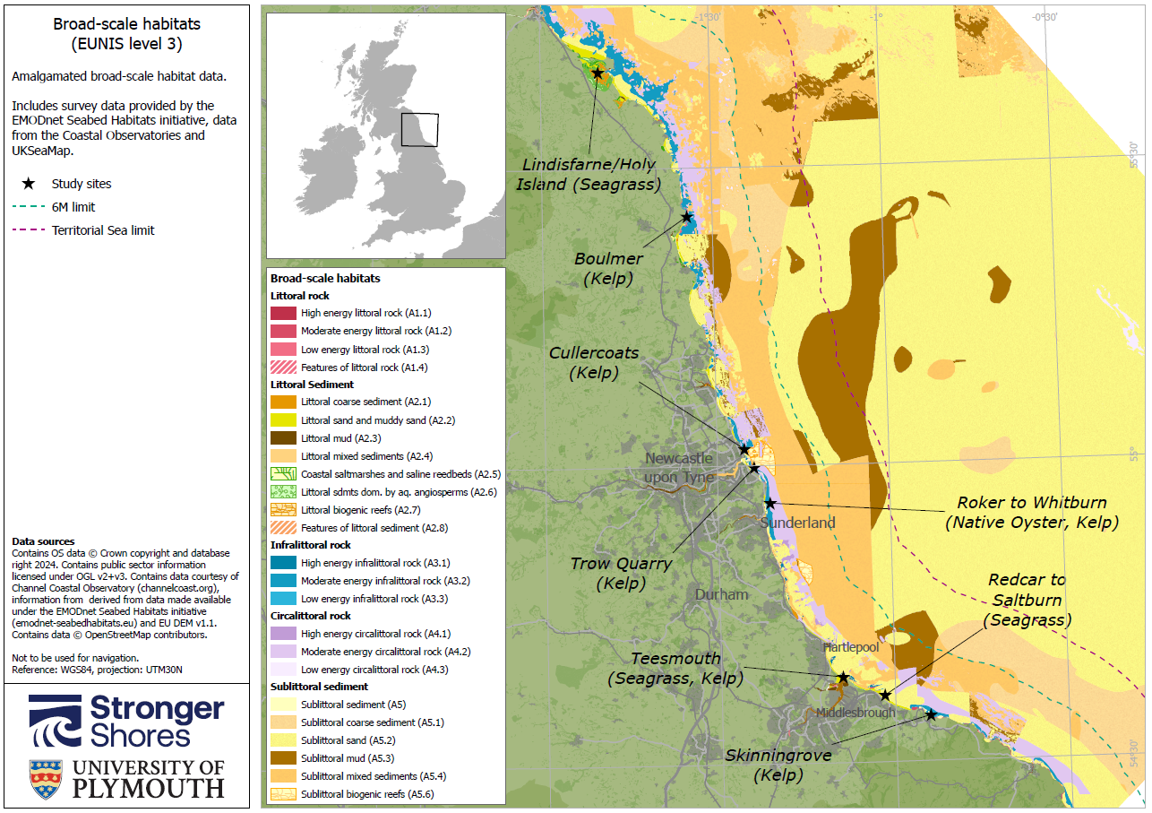
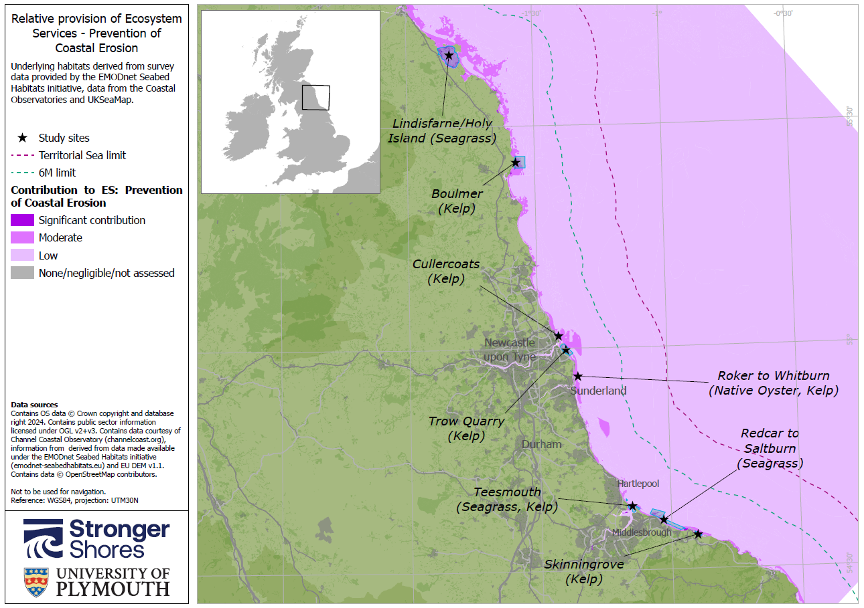
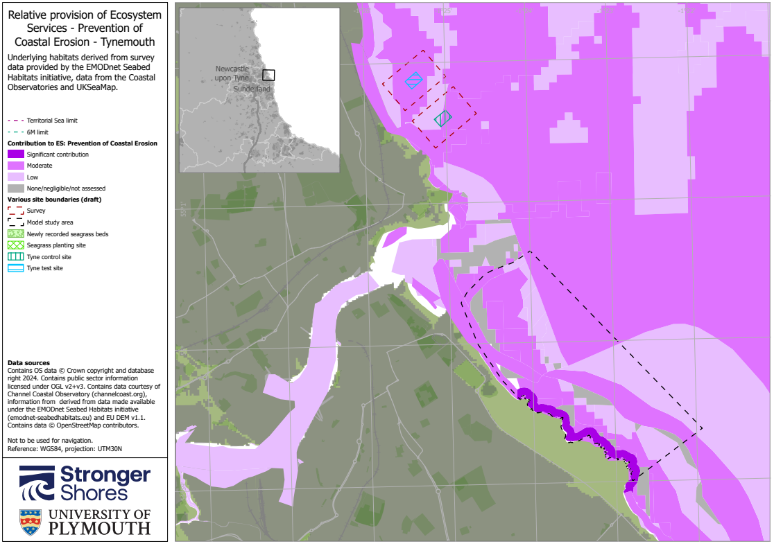
Developing and Appraising Options Report 1: Identifies and describes how (and where) the assets in this area support/provide ecosystem services of…
Prevention of Coastal Erosion & Sea Defence
Food (wild food)
Nature Watching, Recreation and Tourism
A Healthy Climate
Clean Water and Sediments
Notes:
So far we have Identified and described how (and where) the assets in this area support/provide ecosystem services of:
Food (wild food)
Tourism, nature watching and recreation
Sea defence
A healthy climate
Clean water and sediments
It is key to note that generally the availability of ecosystem services is determined by multiple assets– but here (on the right) we can spatially represent the contribution of habitats to an individual ecosystem service. this so these habitats on the right are shaded in purple representing habitats that contribute to maintaining a healthy climate. The darker the colour the more significant that availability of service is, relative to other habitats.
In our first report we define these assets, the ecosystem services within a Plymouth context [and the benefits?]

Slide 9
2) Complied evidence on the current status of the assets
Broad Habitat |  | Detail (with Eunis code) | Extent (km²) | Extent trend | Condition | Condition trend | Pressures: Current or (historical)
Sublittoral habitats
Subtidal reef | Infralittoral rock and other hard substrata (A3) |  | 139.19 | ↔ |  | ↔ | Demersal fishing. Anchoring & mooring
 | A3: Kelp beds on infralittoral rock |  | 129.1 | ↔ |  | ↔ | Siltation from coastal development & dredging. Demersal fishing. Anchoring & mooring
 | Circalittoral rock and other hard substrata (A4) |  | 340.11 | ↔ |  | ↔ | Demersal fishing. Anchoring & mooring
Subtidal sediment | Sublittoral coarse sediment (A5.1) |  | 211.74 | ↔ |  | Limited data | Demersal fishing. Anchoring & mooring
 | Sublittoral sand (A5.2) |  | 415.24 | ↔ |  |  | Demersal fishing. Anchoring & mooring
 | Sublittoral mud (A5.3) A5.336, A5.336 |  | 120.77 | ↔ |  |  | Demersal fishing. Anchoring & mooring
 | Sublittoral mixed sediments (A5.4) |  | 904.6 | ↔ |  |  | Demersal fishing. Anchoring & mooring
 | A5.4: kelp beds on mixed sediment |  | TBC | ↔ |  |  | Demersal fishing. Anchoring & mooring
 | A5.52 - Kelp and seaweed communities on sublittoral sediment |  | TBC | ↔ |  |  | Demersal fishing. Anchoring & mooring
 | A5.5 Sublittoral macrophyte dominated sediment - (A5.53 –Subtidal Seagrass beds) |  | TBC | ↔ |  |  | Demersal fishing. Anchoring & mooring
 | A5.6 Sublittoral biogenic reefs (A5.62 Mussel beds) |  | 0.06 | ↔ |  |  | Demersal fishing. Anchoring & mooring
 | A5.6 Sublittoral biogenic reefs (A5.6 native oyster beds) |  | 0.01 | ↑ |  |  | Demersal fishing. Anchoring & mooring
Water bodies | Overall water body status |  | n = 13 | ↓ |  | ↓ | Nutrient enrichment: 3 water bodies fail GES criteria
Notes:
In the second report
If you remember that it is the status of the asset that determine the ecosystem services available then we have started the process of identifying the current
Extent (so how much do we have of an asset); The condition (so is the asset functioning to make those ES available) and the trend in this data (is this occurring over time)
You can see here where green signals an increase, orange stayed the same and red declined.
Key things to note here are that: whilst there have been increases in the extent of saltmarsh and seagrass beds links to key TECF interventions and an improvement in the condition of subtidal reefs. There are critical declines in the extent and condition of sediments and muds.
[Matt you may have some other key points here about water quality, anchoring and mooring

Slide 11
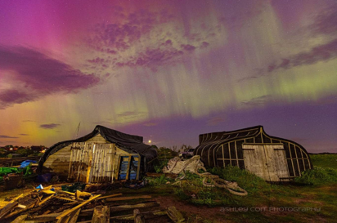
Draft reports will go to steering group and we will also be greatly interested in wider feedback. Today we are running 2 workshops to gather expert knowledge:
1. Benefits and Risk – Nature based Solutions and Natural Capital
Here we will gather input on the Natural Capital Assets and linked Societal Benefits and..
2. Access to appropriate data critical to the Natural Capital approach
@Ashley Cott photography

Slide 12
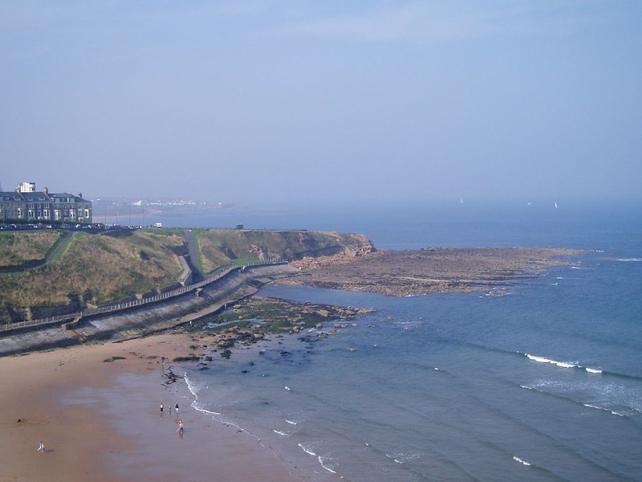
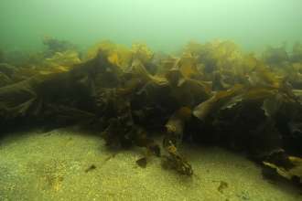
matthew.ashley@plymouth.ac.uk
sian.rees@plymouth.ac.uk

