Slide 1
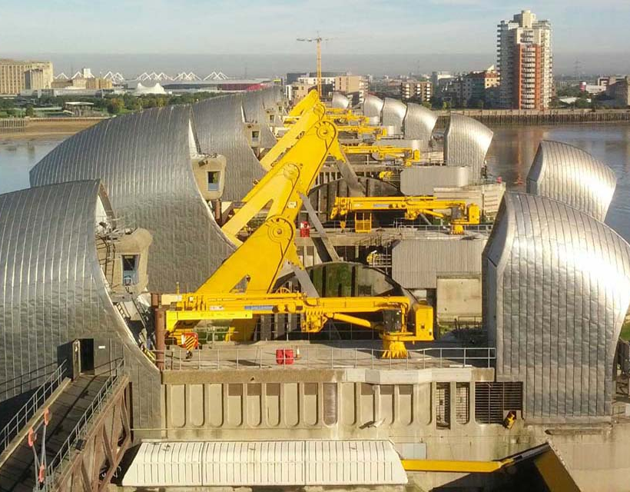
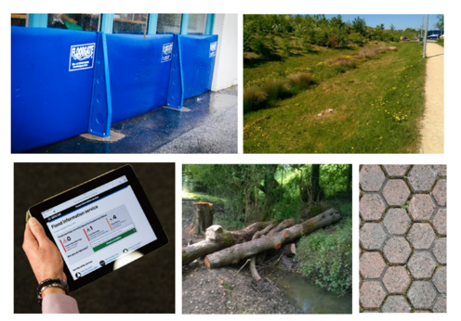
Flood & coastal innovation programmes
Update and what’s next
Andrew Eden
Flood & Coastal Risk Manager & Programme Executive
National Adaptation & Resilience
May 2024

Slide 2
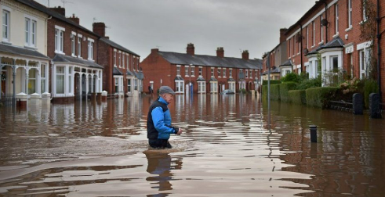
Overview
Context
Resilience
Innovation
Key achievements
The opportunity
Nex steps

Slide 3
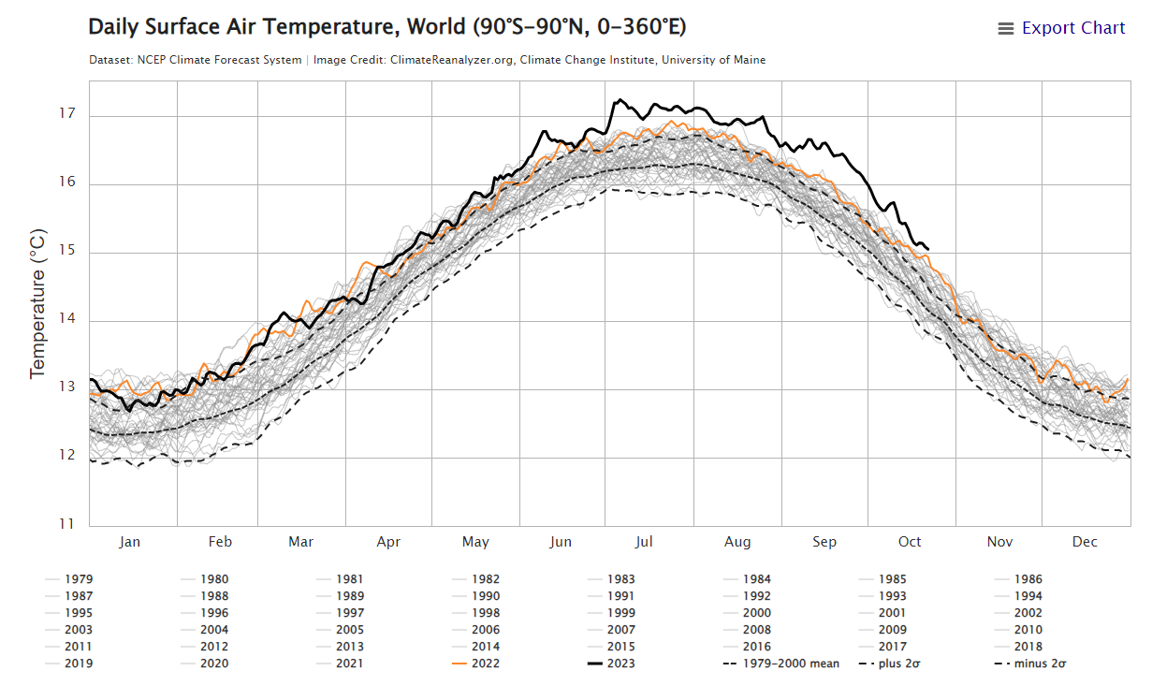
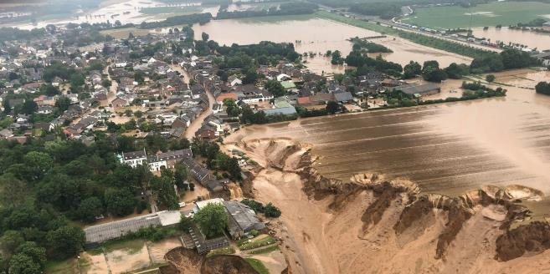
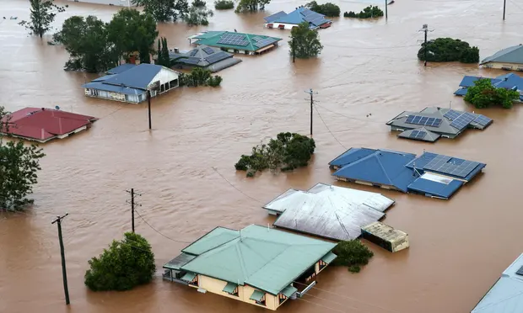
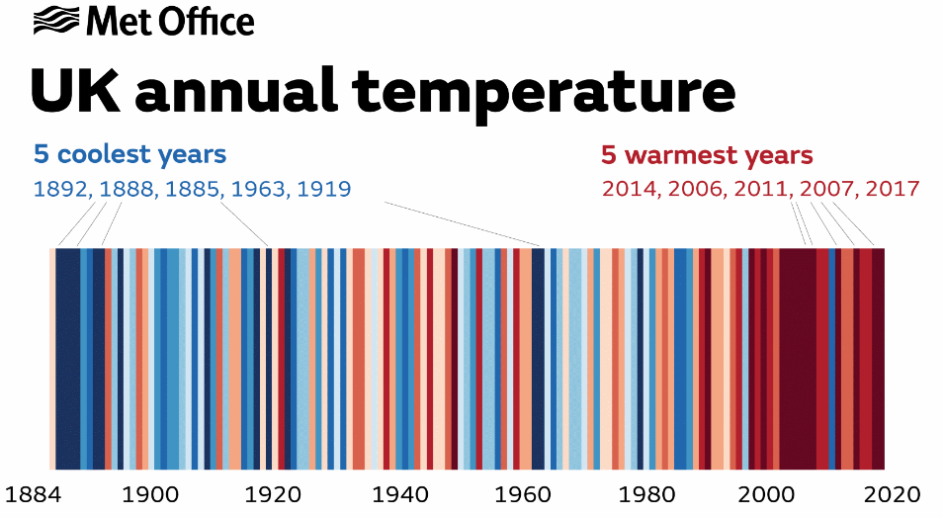
Context Extreme weather and climate change
The climate is changing faster than we can adapt
Birkel, S.D. 'Daily Surface Air Temperature', Climate Reanalyzer (https://ClimateReanalyzer.org), Climate Change Institute, University of Maine, USA. Accessed on 23 October 2023.
Notes:
Images:
Top Left – Homes after flooding in NSW, Aus. Dec 2022 (Source: After the floods: Eugowra awaits the insurance payouts that may not come | NSW and Queensland floods 2022 | The Guardian)
State of the UK climate report 2020:
The decade (2011-2020) was on average 1.1°C warmer than 1961-1990.
Sea level rise has accelerated from an average of 1.5 mm/year from the start of the 20th Century to 3 mm/year for 1993-2019.
Early evidence for heavy rainfall suggests that the frequency of the heaviest rainfall events (95th and 99th percentile) is increasing.
The wettest day on record (since 1891) was on 3rd October 2020 and 4 of the top 40 wettest days on record occurred in 2020.
Mean sea level around the UK has risen by approximately 1.5 mm·year−1 on average from the start of the 20th century, excluding the effect of vertical land movement, resulting in an overall rise of 16.5 cm over that period.
The rate of sea level rise has increased recently, exceeding 3 mm·year−1 for the period 1993–2019.
By 2300 and under the highest of the UKCP18 climate scenarios, we will experience sea levels on average once per year that are equal to or greater than those that we currently expect only once in ten thousand years.
Under high greenhouse gas concentrations, flood damages, globally, will increase to 4% of annual world GDP by 2100 without adaptation
Over the next 20 years, approximately 700 properties in England will be vulnerable to coastal erosion. A further 2,000 properties may become vulnerable over the next 50 years.
For London, sea level rise by the end of the century (when compared to 1981-2000), is ‘extremely likely’ to be in the range 0.29m to 0.70m for the low emission scenario, and 0.53m to 1.15m for a high emission scenario.
Over two-thirds of properties in England are served by infrastructure sites and networks located in, or dependent on others located in, areas at risk of flooding
Risks are increasing with climate change and accelerating at a rate not seen before
By 2100 once-a-century sea level events are set to become annual events.
Summer rainfall is projected to decrease by 22% and winter rainfall is expected to increase by 13% by the 2080s
40 million early warning messages sent for river and sea flooding over the past 10 years
Parts of England's coast are amongst the fastest eroding coastline in Europe. – e.g. rate of erosion in East Riding, Yorkshire is 1 m to 1.5 m per year. North Norfolk is 1.7 m per year. The national coastal erosion risk map show us that approximately 700 properties in England are vulnerable to coastal erosion over the next 20 years. A further 2,000 properties may become vulnerable over the next 50 years. These estimates take account of the interventions proposed in shoreline management plans (SMPs). Without the interventions, these figures could increase to about 5,000 properties within 20 years and about 28,000 in 50 years.
On 6 March 2023 our FCERM research and Development Programme published a report on GOV.UK on ‘Climate change and fluvial flood peaks’. This important project began in 2016 and generated new projections of how river flood peaks may change due to climate change. These projections were then used as the basis for the peak river flow allowances for use in flood risk assessments which were published in July 2021. The report is also referenced in the Environment Agency’s Chief Scientist’s annual review 2022, published on 7 March 2023.
Further Background
CLIMATE CHANGE
Climate change is the biggest risk we face.
Climate change is already changing our weather and increasing our risks of flooding and coastal change.
We want to become a net-zero carbon organisation by 2030 and to explore if we can be an absolute-zero organisation by 2050.
his will be a great challenge to our ways of working.
We will continue to build, operate and maintain assets to protect people and wildlife and ensure our actions deliver the best climate resilience to communities for the investment available.
Reducing carbon to mitigate climate change is a core part of protecting communities for the future.
We are developing a new National Flood Risk Assessment that will provide a single picture of current and future flood risk from rivers, the sea and surface water.
Adaptation
Living Differently in a Changing Climate
Climate change is happening now. We’re seeing more extreme weather, with an increase in flooding, coastal erosion and landslips.
We’re working to better protect communities from this risk and make homes and businesses better prepared and more resilient.
The climate emergency means we cannot always prevent or build our way out of an incident, so we need to ensure people have access to the information they need to prepare, act, survive.
Existing climate risks have far-reaching consequences for England’s communities, economy, and environment
The Environment Agency alone cannot protect everyone from increasing flood and coastal risks.
Climate change will accelerate sea level rise and alter rainfall patterns.
Traditional flood defences will not be able to prevent all flooding and coastal erosion.
This is why we are shifting towards flood resilience approaches to live with increasing risks more effectively, such as NFM and property-level protection.
Background info
COP27
From 6 to 18 November 2022 , Heads of State, ministers, and negotiators, along with climate activists, mayors, civil society representatives and CEOs met in the Egyptian coastal city of Sharm el-Sheikh for the largest annual gathering on climate action.
The 27th Conference of the Parties to the United Nations Framework Convention on Climate Change – COP27 – builds on the outcomes of COP26 to deliver action on an array of issues critical to tackling the climate emergency – from urgently reducing greenhouse gas emissions, building resilience, and adapting to the inevitable impacts of climate change, to delivering on the commitments to finance climate action in developing countries.
Faced with a growing energy crisis, record greenhouse gas concentrations, and increasing extreme weather events, COP27 seeks renewed solidarity between countries, to deliver on the landmark Paris Agreement, for people and the planet.
The provisional 2022 State of the Global Climate study released by the UN World Meteorological Organization (WMO) on 6 November 2022 outlines the increasingly dramatic signs of the climate emergency, which include a doubling of the rate of sea level rise since 1993, to a new record high this year; and indications of unprecedented glacier melting on the European Alps.
The full 2022 report is due to be released in the Spring of 2023, but the provisional study was brought out ahead of COP27, the UN climate conference, raising awareness of the huge scale of the problems that world leaders must tackle, if they are to have any hope of getting the climate crisis under control.
IPCC Report:
As greenhouse gas emissions continue, warming of the globe will continue.
Without serious efforts to reduce greenhouse gas emissions, global temperatures are likely to rise by more than 2°C over the next century and could rise by as much as 5°C.
The risk of some extreme events, particularly heat waves and heavy rainfall, are expected to increase further in coming decades.
Global sea level is predicted to rise between 0.26 and 0.81 m by the end of this century and it will continue to rise for centuries to come .

Slide 4
Environment Agency What we do
Our role
Partner
Regulator
Infrastructure operator
Trusted Advisor
Advising on new development & infrastructure
Building and maintaining flood and coastal defences
Strategic overview of flood and coastal risk management
Monitoring & data
Risk and investment modelling and projections
Climate advice
Regulation
Biodiversity Net Gain
Net zero by 2030
Innovation
How…
Ensuring people and places are resilient and able to adapt
Developing new methods through innovation
Decarbonising our activities

Slide 5
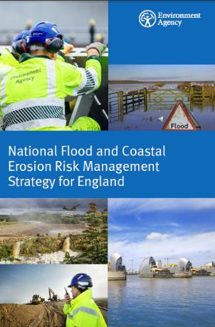
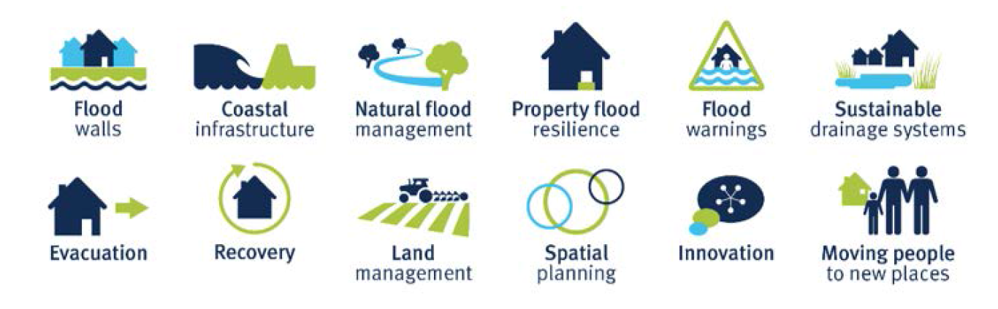
Resilience The FCERM Strategy
“a nation ready for, and resilient to, flooding and coastal change – today, tomorrow and to the year 2100”
Notes:
Our FCERM Strategy has three long term ambitions:
Climate resilient places
Working with partners to bolster resilience to flooding and coastal change across the nation, both now and in the face of climate change.
Today’s growth and infrastructure resilient in tomorrow’s climate
Making the right investment and planning decisions to secure sustainable growth and environmental improvements, as well as infrastructure resilient to flooding and coastal change.
A nation ready to respond and adapt to flooding and coastal change
Ensuring local people understand the risks posed by flooding and coastal change, are responsible for managing the impacts and know how to take action.
The three ambitions inform and are underpinned by continuing to develop our understanding of risk now and in the future. We also use this evidence to identify our investment needs.

Slide 6
Innovation £200m Flood & coastal innovation programmes
3
35 projects
30 local authorities
£8m
Adaptation pathways programme
4 EA teams developing
adaptation pathway
plans with local
partners
£150m
Flood & coastal
resilience innovation
programme
25 local authorities
delivering
resilience
actions
Unique programmes
324
£200m
£200m FCIP
Organisations
~500
6
YEARS
Project staff
2021-2027
£36m
Coastal transition accelerator programme
We will drive innovation in flood and coastal resilience and adaptation to a changing climate. We’re investing £200 million to test and develop new ways to create a nation resilient to flooding and coastal change.
Notes:
Constructing new defences and strengthening existing is not the only and not necessarily the best or most appropriate way to adapt to coastal change - coastal transition and making more use of nature based solutions will support coastal communities and the environment to thrive in a changing climate.
Flood and Coastal Innovation Programmes
We are committed to developing better ways of improving the nation’s resilience and ability to adapt to flooding and coastal change. We are investing £200 million in our Flood and Coastal Innovation programmes between 2021 and 2027. These programmes sit alongside and will inform our £5.2 billion FCERM capital investment programme. The programmes comprise:
The £150 million Flood and coastal resilience innovation programme which will enable local authorities, businesses and communities in 25 places to test and demonstrate innovative practical resilience actions (such as nature-based solutions; enhanced flood warning systems; community and voluntary sector action) to ensure people and places are able to better plan and prepare for flooding and coastal change and recover quickly when it does happen.
The £8 million Adaptive pathways programme which will develop long term investment plans for managing flooding and coastal change to 2100 and beyond in strategic locations including the Thames Estuary, Humber Estuary, River Severn and Yorkshire.
The £36 million Coastal transition accelerators programme which will support communities in areas at significant risk of coastal erosion to transition and adapt to a changing climate.

Slide 7
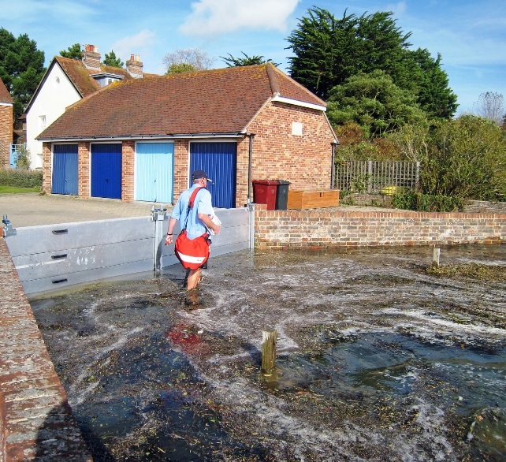
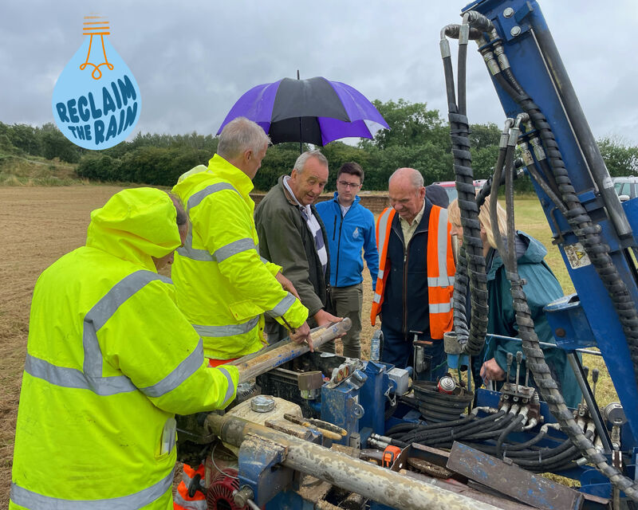
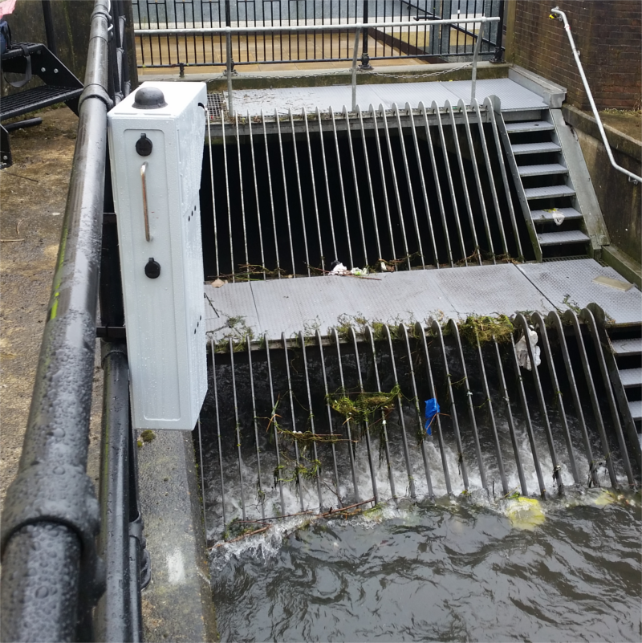
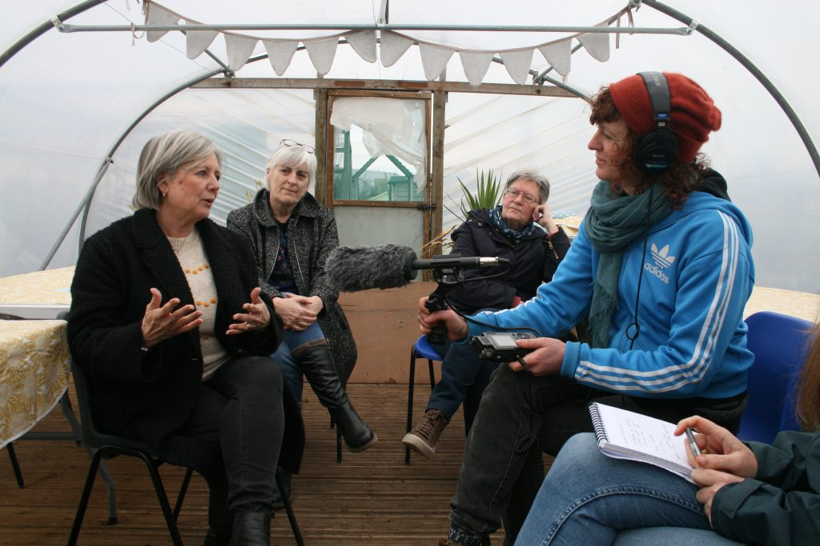
Innovation £200m Flood & coastal innovation programmes
Unique to Defra – opportunity to make the case for change
Test and pilot new ways of delivering adaptation and resilience
Generate evidence on costs and benefits of resilience and adaptative action
Enhance local resilience and adaptive capacity
Use evidence to inform future policy and investment
7
Notes:
So what are we doing?
(Clockwise from top left)
Community and property flood resilience – example photo from RAIN
Sustainable water management – Reclaim the Rain photo working to integrate abstraction with flood risk management
Catchment and coastal nature based solutions – includes natural flood management and coastal NBS – shoutout to Stronger shores – seagrass, kelp and oysters
Technology – trailing of AI for flood warning and blockage dectection
Monitoring of assets – better intel into how assets are working and how we can proactively maintain and manage them
Engagement and community action – Blue Heart are working with communities to empower – listening and supporting community funds

Slide 8
Key achievements A breakdown of both physical and non-physical assets created by the project and programme teams to date
Physical assets
12
Information & data
Knowledge
276
9
30
47
Habitats Improved
24
14
Measurement & monitoring assets
Strategic plans & policies implemented
Guidance, learning reports
Natural flood management systems
FCERM models
SuDS
50
2
4
9
19
~1000
Households benefiting from PFR
Research & innovation Assets and activities (e.g. journal articles, PhDs, reports)
Flood & water management control assets
Emergency response units
Other tools and models (i.e. Non FCERM)
Datasets created
Engagement & recognition
Community & social
Financial
8
9
Local flood/ coast warning services
47
54
£3.25m
Engagement initiatives with education and schools
7/10
Engagement & cultural assets
Engagement Initiatives
Partner funding secured
14
Series of workshops, stakeholder events and other engagement actions
4
7
29
£693k
Digital platforms
Community recreation assets
Practioner groups
Community groups
Community funds created
Notes:
Assets in the Flood and Coastal Innovation Programme have a wider definition than typical FCERM programmes. This is key because when it comes to Innovation, innovation outputs and outcomes are not always physically tangible, and various outputs can create or generate innovative spaces thus leading to more innovative outcomes.
Physical Assets -
Tangible structures and equipment for flood management, habitat, drainage systems, monitoring tools.
Informational Assets -
Models, plans, strategies, datasets, and tools aiding informed decision-making for resilience.
Engagement and Recognition Assets -
Events, activities, promoting community preparedness/ responsiveness/ recovery, along with engagement activities linked to education/knowledge sharing and educational institutions.
Community and Social Assets -
Tangible services, spaces, initiatives, fostering community resilience.
Financial Assets -
Funding sources, community funds, and supported groups contributing to resilience efforts.
Knowledge Assets -
Guides, research, and documentation facilitating resilience actions and informed strategies.

Slide 9
Opportunity What this means….
We can shape the future of flood and coastal risk management
Demonstrate wider benefits of taking resilience-led approach
Quantify the financial benefits – justifying future investment
Make the case for continued innovation in the sector
In the Stronger Shores context, real focus should be on quantifying the wider benefits (not just for FCERM but environmental, social and economic) – future projects cannot rely on FCEERM funding alone – we will need to stack benefits and build wider partnerships and contributions
9

Slide 10
Next steps Our priorities for the next 36 months
Co-ordinating evidence basis
Engaging key FCERM influencers
Growing FCIP project and programme profiles
Notes:
Winter forum
Successes
Barriers
Challenges
MPR
Next 36 months
Co-ordinating evidences bases
Engaging key influencers FCERM influencers
Growing FCIP projects and programme profiles

